Slide 1
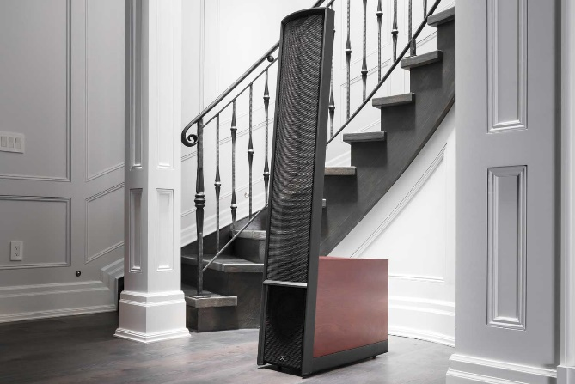
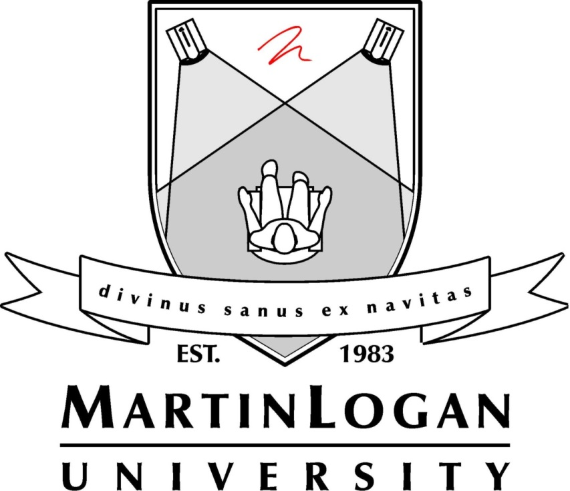
2019 Dealer Training

Slide 2
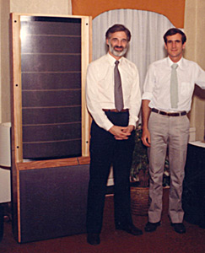
Who is MartinLogan?
Brand Story – The Beginnings
Gayle
Martin
Sanders
Ron
Logan
Sutherland
Notes:
People often assume that MartinLogan was founded by a couple of guys named Martin and Logan, which is sort of true: Gayle Martin Sanders and Ron Logan Sutherland. MartinLogan "just sounded better than SandersSutherland," Sanders explains. (Apparently they never considered GayleRon.)
The two were students at KU and met in the late '70s at a high-end audio store Sanders managed in Lawrence, Kansas. Despite very different backgrounds—Sanders had trained in architecture and advertising, Sutherland in electrical engineering—they shared a passion for music and, they soon discovered, electrostatic loudspeakers.

Slide 3
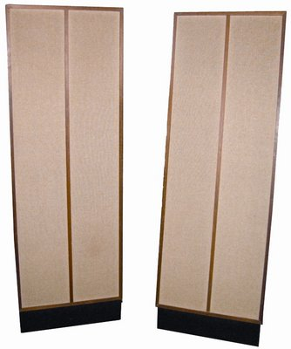
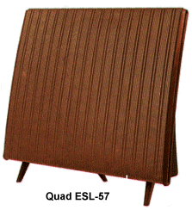
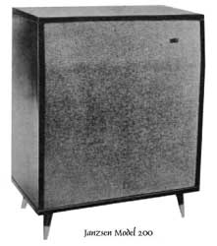
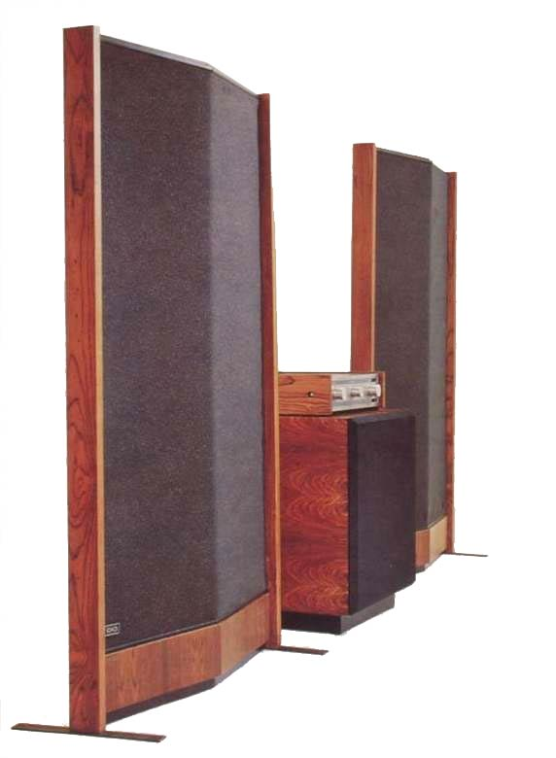
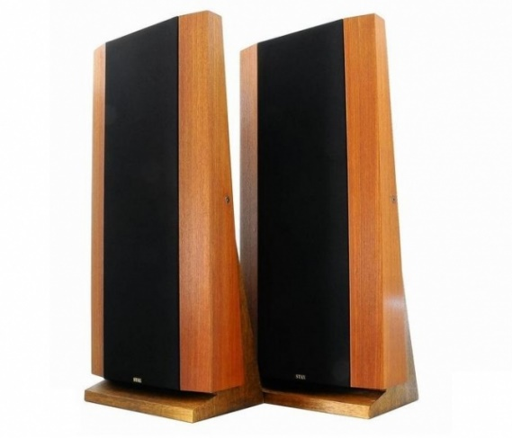
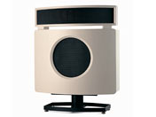
Who is MartinLogan?
Brand Story - The Inspiration
_{Janszen Model 200} ₍₁₉₅₉₎
_{Quad ESL57} ₍₁₉₅₇₎
_{KLH Model 9} ₍₁₉₆₂₎
_{B&W DM70} ₍₁₉₇₄₎
_{Infinity Servo-Statik 1 (1968)}
_{Stax ELS F-81} ₍₁₉₈₁₎
Notes:
For anyone seeking the ultimate in sonic purity and clarity, electrostatics held enormous appeal. Unfortunately, designing and building one that will also produce the sound levels and bass extension most people expect from a loudspeaker is a formidable challenge, even today. Back then, only a relative handful of electrostatic speakers had ever been brought to market. Although most were failures, a few, such as the KLH Model 9 and Quad ESL, were legendary among audio enthusiasts.
The KLH probably came closer than any other full-range electrostatic speaker of its day to competing effectively with conventional speakers in bass and output capability. It was very big, however, and finicky and expensive, and it didn't fit in at all with the rest of KLH's line. Consequently, sales were modest, and eventually the Model 9 went out of production. The Quad ESL was much more successful, especially in its native England, and until MartinLogan's products came on the scene it was arguably the only commercially significant electrostatic loudspeaker in history. It suffered the classic limitations of the breed, however. Though the original Quad electrostatic was widely regarded as the world's finest reproducer of chamber music, fans of rock and even symphonic music were inclined to look elsewhere.

Slide 4
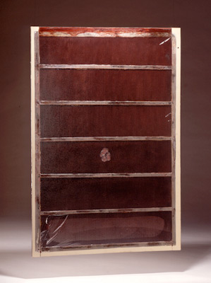
Who is MartinLogan?
Brand Story – 1979 Finding a better way
The prototype that would inspire the pursuit of
Truth in Sound.
Notes:
Sanders and Sutherland convinced each other they could do better. They were sure they could build an electrostatic speaker that would produce adequate bass, output, and sound dispersion without arcing, blowing up amplifiers, or otherwise offending people not interested in a living-room science project. Sanders organized a small research and development team to transform an original design he had tinkered with for more than a decade into a practical, marketable electrostatic transducer.
The first prototype was ready in 1979. Naturally, it still had that science-project quality—a flat aluminum panel sprouting wires, struts, transformers, and power supplies, connected to an amplifier in Sanders' living room. It sounded even better than expected, but when they turned up the volume, a lightning storm erupted across the panel and music was replaced by a plume of smoke drifting toward the ceiling. Still, they knew they were close.

Slide 5
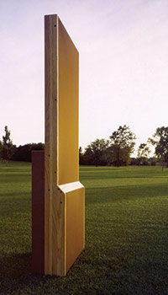
Who is MartinLogan?
Brand Story – 1982 Finding a better way
The state of the art prototype with many technology advancements that would become our first product, the original Monolith.
Notes:
The team began a series of experiments with new aerospace materials that led to a design breakthrough. Constructed with state-of-the-art conductive coatings, insulation, and adhesives, their revised transducer sandwiched a clear, ultra-light Mylar diaphragm between two perforated-steel stators.
The new speaker looked elegant and could play loudly without arcing, but Sanders still struggled with how to achieve satisfactory high-frequency dispersion without compromising sound quality. (Large transducers tend to radiate high frequencies in a narrow beam rather than fanning them over a wide area.) The solution came in a midnight session when Sutherland sketched a theoretical sound wave to illustrate how sound disperses. Sanders envisioned a horizontally curved panel, the curvilinear line-source, or CLS, transducer central to the design of every MartinLogan electrostat since.
With only a mock-up and some photographs, Sanders and Sutherland exhibited their speaker concept at the 1982 Consumer Electronics Show in Chicago. An instant hit, the design was honored with a CES Design and Engineering Award. Excited by the response, they headed home to Kansas to translate their ideas into a working prototype.

Slide 6
Who is MartinLogan?
Brand Story – 1983 MartinLogan begins with the Monolith
The product that launched our brand. Implementing the core technology advancements that made ESLs practical and viable for nearly any application.
Notes:
Through a network of high-technology manufacturers, Sanders and Sutherland enlisted the help of other engineers with cutting-edge expertise and interest in the project. The company that fabricated the space shuttle's filtered windows and the people who created Teflon-coated cookware joined the design team. From their combined effort emerged a patented vapor-deposition process, an optically transparent diaphragm that could support a 5,000-volt charge, and a conformal coating that uniformly insulated each perforated stator to a charge of up to 10,000 volts.
By the time of the 1983 CES, they had developed a full-range hybrid electrostatic loudspeaker they called the Monolith. A renowned high-end audio company used a prototype pair in its room at the show to demonstrate its electronics. Dealers who heard them were bowled over by the sound of the visually stunning, see-through Monoliths and, more importantly, eager to sell them. It was at this point that Sanders and Sutherland put their middle names to the venture and set about satisfying the demand they had created. MartinLogan finally took flight.
The first couple of years were touch and go. Working with just one full-time and one part-time employee, they built and shipped the first 10 pairs of Monoliths. Despite specially designed cartons, three pair were ruined in freight—a near-catastrophic loss for the young company. Undeterred, they rebuilt the speakers and pressed on, establishing in the process the guaranteed-satisfaction policy that stands behind MartinLogan quality and workmanship to this day.
Sales started to surge in 1985, and the company was finally on a firm footing. Sutherland departed to return to his first love, electronics. The next year MartinLogan moved to its current location at 2001 Delaware Street. At the same time international distribution for the Monolith took off with startling success.

Slide 7
Design Philosophy
Less is more, Truth in Sound.
Eliminating sources of distortion or coloration brings the customer closer to the source material, regardless of what that might be.
Our goal is to achieve the most accurate reproduction of content at any given price point through successful implementation of superior technologies.
In other words, we strive to reach the Truth in Sound.

Slide 8
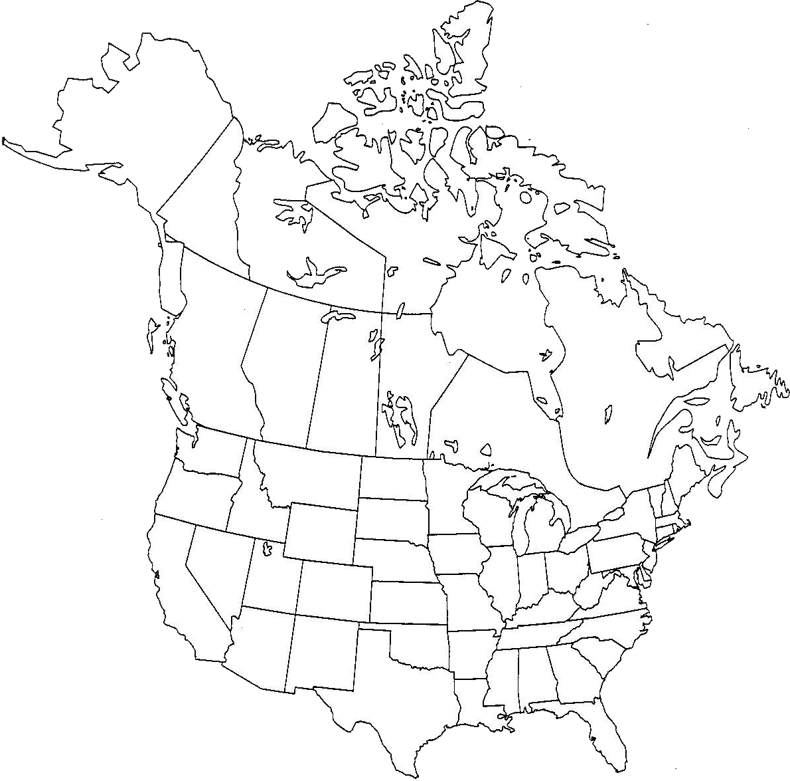
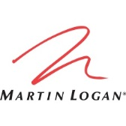
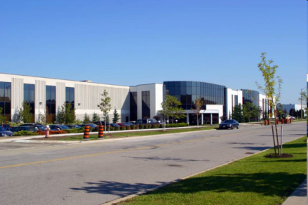
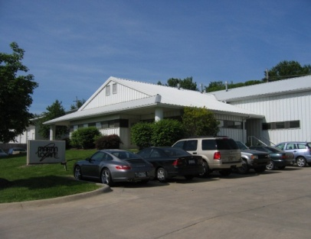
Who is MartinLogan?
The company today – Lawrence, KS and Canada
Based in the heartland of the USA. Built in North America.
Notes:
When Gayle retired in 2005, he wanted to ensure that the future of the company he had poured his blood, sweat and tears into was left in good hands. An investment company specializing in well run, private audio companies acquired MartinLogan and we joined under the same umbrella as our brothers and sisters at Paradigm and Anthem.

Slide 9
Who is MartinLogan?
The company today: Lawrence, KS
Notes:
When Gayle retired in 2005, he wanted to ensure that the future of the company he had poured his blood, sweat and tears into was left in good hands. An investment company specializing in well run, private audio companies acquired MartinLogan and we joined under the same umbrella as our brothers and sisters at Paradigm and Anthem.

Slide 10
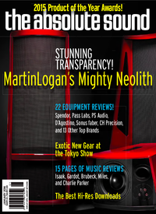
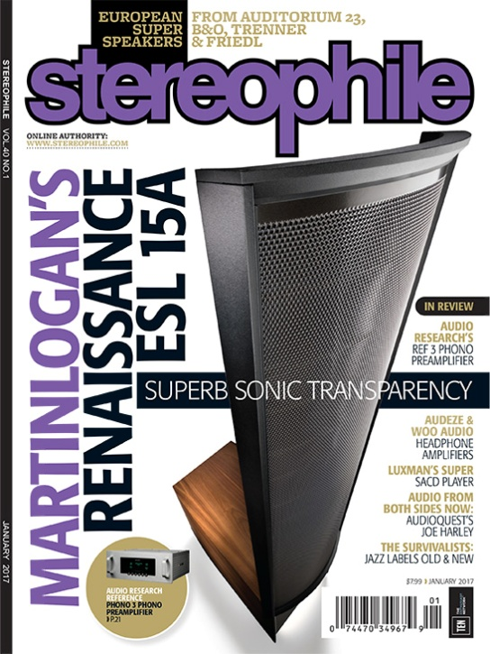
Who is MartinLogan?
An Award Winning Legacy: Well over 75 Awards Since 2010 alone…and counting!

Slide 11
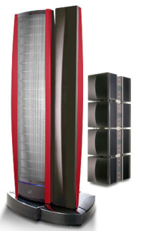
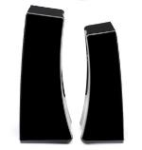
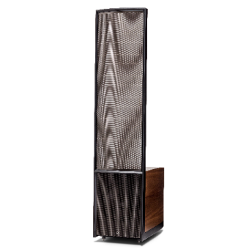
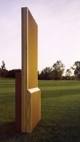
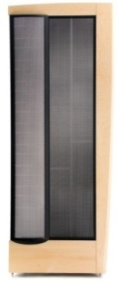
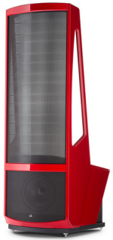
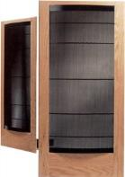
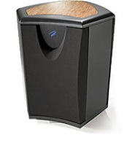
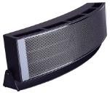
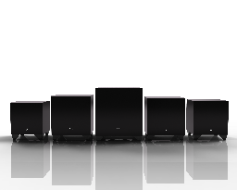
Who is MartinLogan?
MartinLogan timeline (1979-2016)
₁₉₇₉
₁₉₈₂
₁₉₈₃
₁₉₈₆
₁₉₉₂
₁₉₉₄
₁₉₉₉
₂₀₀₁
₂₀₀₅
₂₀₀₈
₂₀₁₀
₂₀₁₄
₂₀₁₆
₂₀₁₈
_{CES} _{Prototype}
_{Summit}
_{Neolith}
_{Masterpiece} _{Series}
_{All new Dynamo models}
_{Statement e2}
_{Descent}
_{Motion} _{Series}
_{CLS}
_{CLX}
_{First} _{Panel}
_{Aerius}
_{MartinLogan} _{Begins}
_{Logos}

