Slide 1
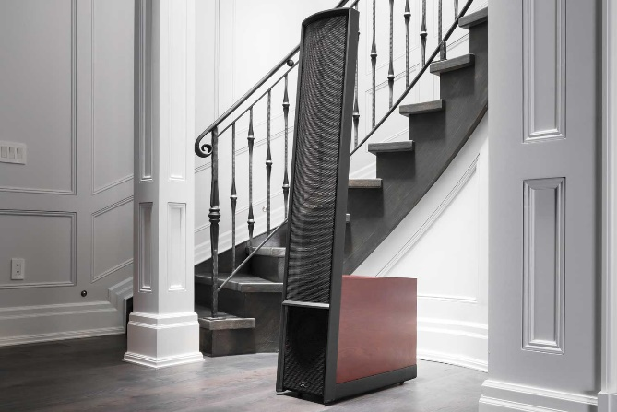
2019 Dealer Training

Slide 2
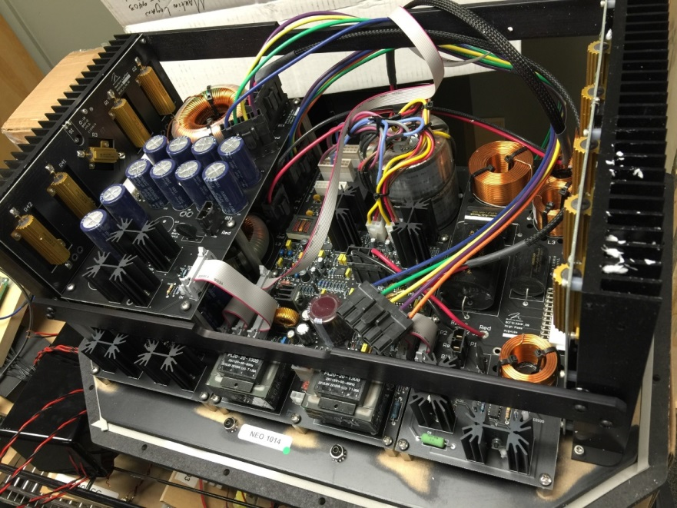
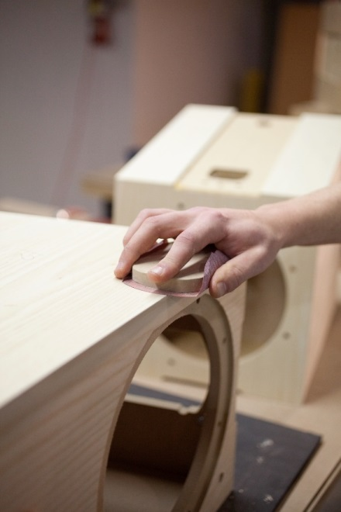
Achieving ”Truth In Sound”
3 main speaker components
Drivers
Crossover
Cabinet

Slide 3
Achieving ”Truth In Sound”
3 main speaker components
Drivers

Slide 4
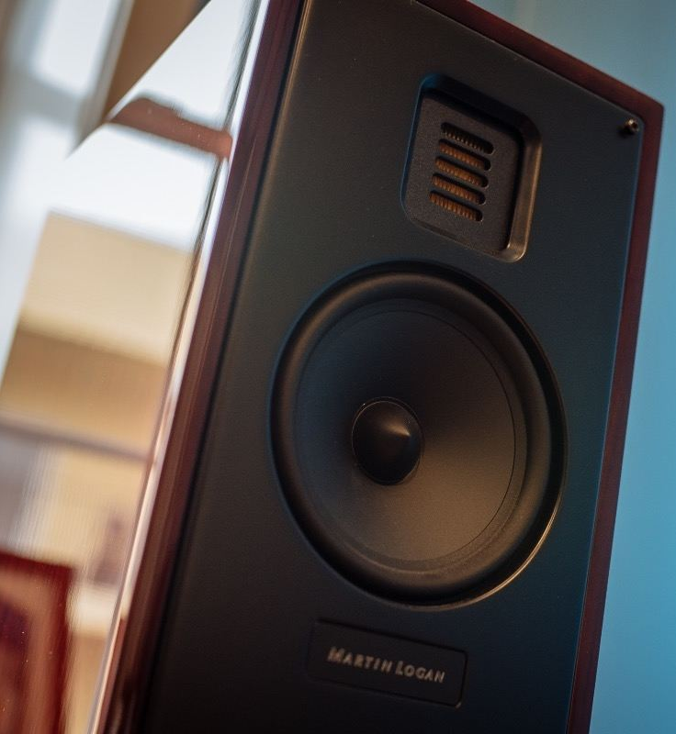
Folded Motion Tweeter
Electrostatic Technology

Slide 5
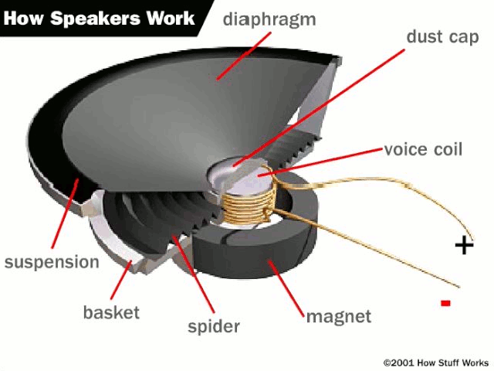
How Conventional Drivers Work
“Cone” and “Dome” Drivers
Animation courtesy of “How Stuff Works.”
Notes:
But before we can appreciate the operation of a thin film driver… let’s review how a conventional cone driver works… this can apply to virtually EVERY speaker manufacturer in the industry today. Even our own (point to the conventional drivers in a Clarity or Mosaic, etc.)
The key ingredient to a conventional drivers operation is the voice coil… this is essentially a coil of copper wire wrapped around a device called the former.
Anytime we apply electrical current into a coil of wire we create a what? Magnetic field… reaching back to the school days with that one. If we use a certain type of electrical current called AC or alternating current we can now change the polarity of that magnetic field created by the coil… kind of like flipping a magnet over and over quickly would do.
If we take this coil of wire and now install it into a stationary magnetic field (aka a big ceramic magnet on a 6.5 woofer) that coil is now attracted to and repelled from the magnet based on the musical signal

Slide 6
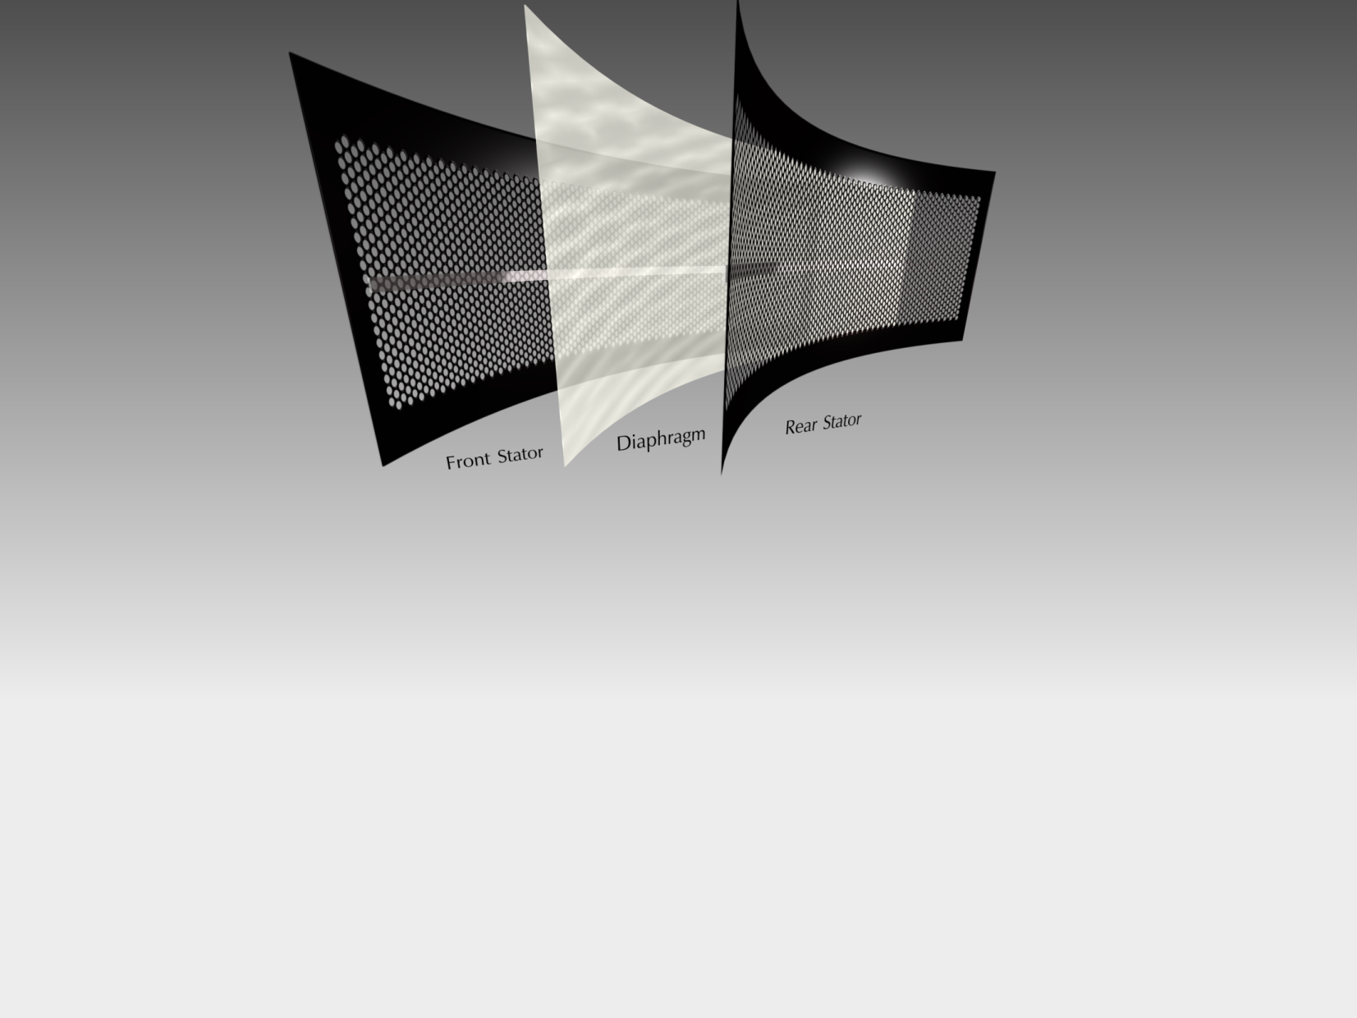
Notes:
In a ML ESL loudspeaker the signal from your amplifier DOES NOT pass through the diaphragm (clear film) of the speaker… in an ESL the signal actually passes through the stators (point). In this instance the diaphragm has a constant positive charge (from plugging it into the wall). You may want to point to the power supply of your Clarity. In case you are curious… the reason you do not get shocked when you touch the surface of the stator is because they are insulated via a powder coating process we perform.
The electrical signal of your amplifier flows through the surface of the stator in an opposing manner… in other words, when the front stator has a positive charge, the back stator has a negative charge… and vice versa. As this process occurs, the diaphragm is attracted to and repelled from both the front and rear stators
This process causes the diaphragm of the ESL loudspeaker to move forward and back… which moves air. Anytime we move air, we create? Sound!!!

Slide 7
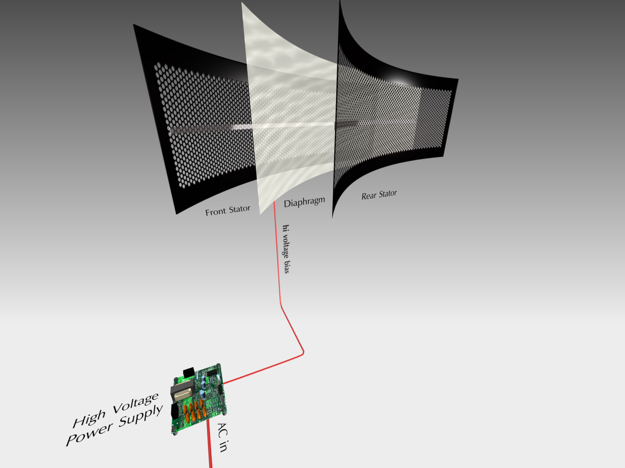
Notes:
In a ML ESL loudspeaker the signal from your amplifier DOES NOT pass through the diaphragm (clear film) of the speaker… in an ESL the signal actually passes through the stators (point). In this instance the diaphragm has a constant positive charge (from plugging it into the wall). You may want to point to the power supply of your Clarity. In case you are curious… the reason you do not get shocked when you touch the surface of the stator is because they are insulated via a powder coating process we perform.
The electrical signal of your amplifier flows through the surface of the stator in an opposing manner… in other words, when the front stator has a positive charge, the back stator has a negative charge… and vice versa. As this process occurs, the diaphragm is attracted to and repelled from both the front and rear stators
This process causes the diaphragm of the ESL loudspeaker to move forward and back… which moves air. Anytime we move air, we create? Sound!!!

Slide 8
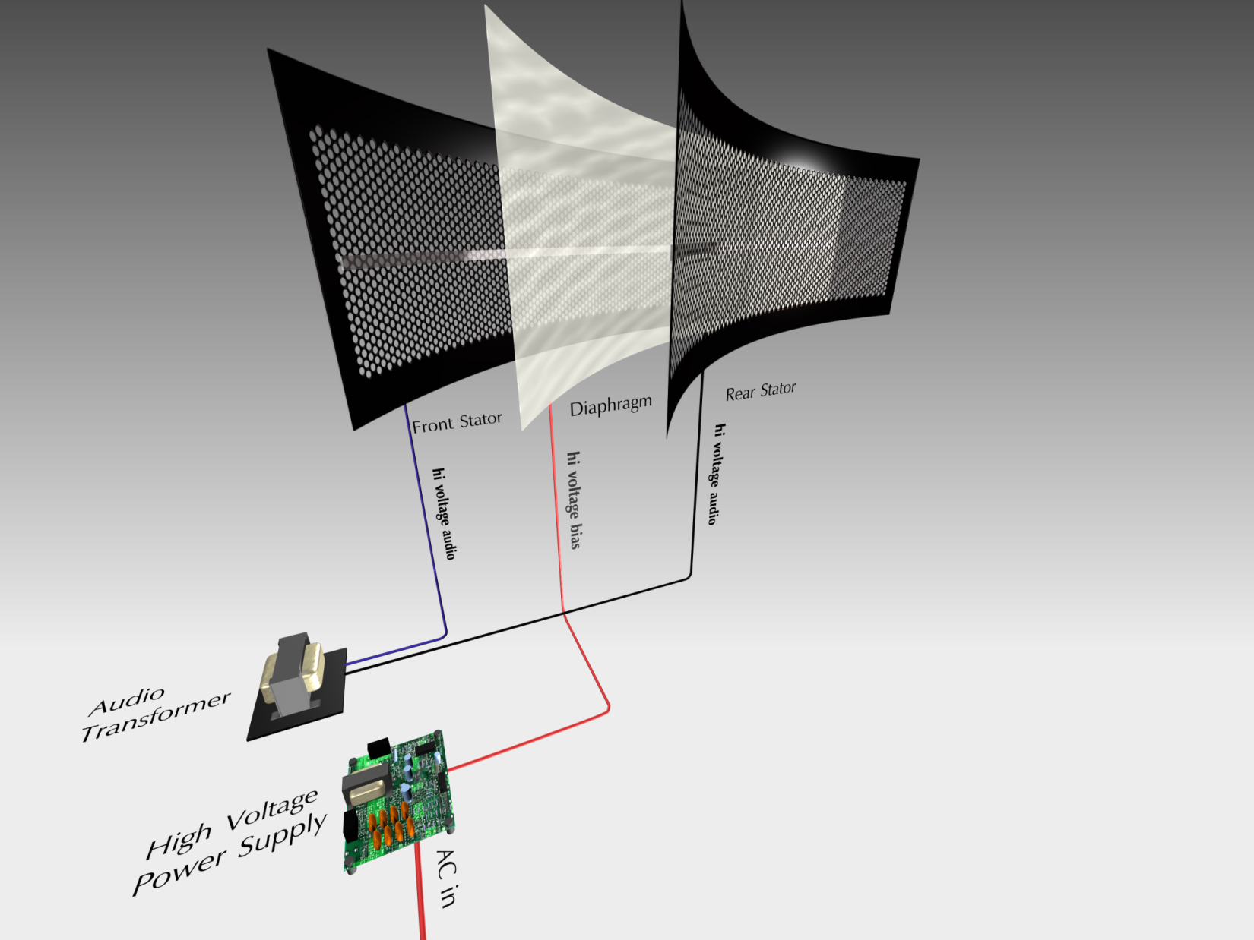
Notes:
In a ML ESL loudspeaker the signal from your amplifier DOES NOT pass through the diaphragm (clear film) of the speaker… in an ESL the signal actually passes through the stators (point). In this instance the diaphragm has a constant positive charge (from plugging it into the wall). You may want to point to the power supply of your Clarity. In case you are curious… the reason you do not get shocked when you touch the surface of the stator is because they are insulated via a powder coating process we perform.
The electrical signal of your amplifier flows through the surface of the stator in an opposing manner… in other words, when the front stator has a positive charge, the back stator has a negative charge… and vice versa. As this process occurs, the diaphragm is attracted to and repelled from both the front and rear stators
This process causes the diaphragm of the ESL loudspeaker to move forward and back… which moves air. Anytime we move air, we create? Sound!!!

Slide 9
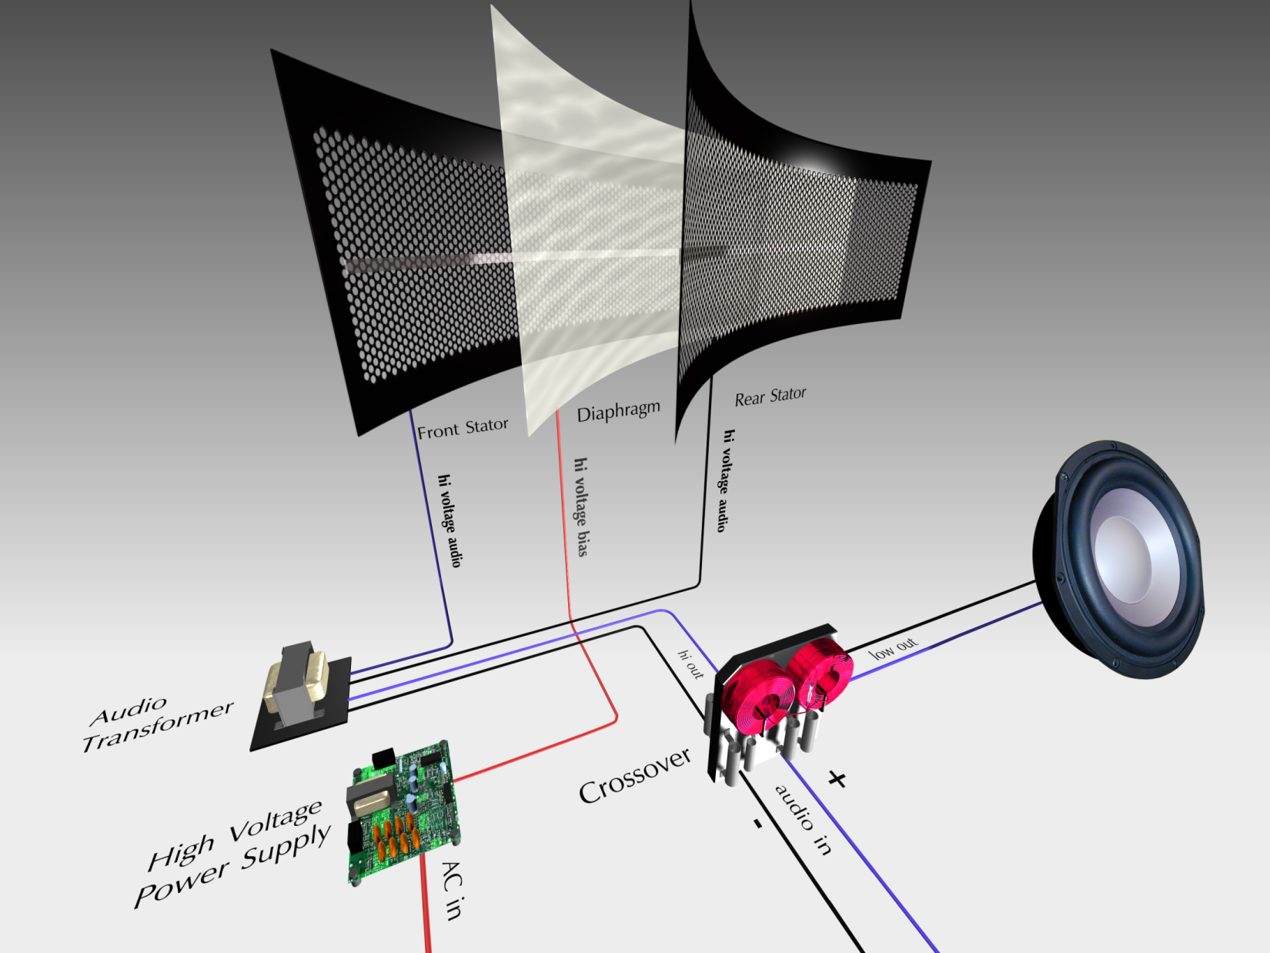
Notes:
In a ML ESL loudspeaker the signal from your amplifier DOES NOT pass through the diaphragm (clear film) of the speaker… in an ESL the signal actually passes through the stators (point). In this instance the diaphragm has a constant positive charge (from plugging it into the wall). You may want to point to the power supply of your Clarity. In case you are curious… the reason you do not get shocked when you touch the surface of the stator is because they are insulated via a powder coating process we perform.
The electrical signal of your amplifier flows through the surface of the stator in an opposing manner… in other words, when the front stator has a positive charge, the back stator has a negative charge… and vice versa. As this process occurs, the diaphragm is attracted to and repelled from both the front and rear stators
This process causes the diaphragm of the ESL loudspeaker to move forward and back… which moves air. Anytime we move air, we create? Sound!!!

Slide 10
How a ML Electrostatic Driver Works
MartinLogan Xstat ESL
Notes:
The Stators are charged with alternating and opposite charges from the signal coming from your amplifier. Those alternating polarities simultaneously attract and repel the (always postive) thin film Diaphragm which causes it to move back and forth and thus exciting the air and producing sound. This diaphragm is so precisely controlled and so light in weight that it effectively tracks the incoming signal as perfectly as possible. Many microphones used for recording are electrostatic designs.

Slide 11
Key Benefits of ESL Technology
The 4 L’s:
Lightweight Driver Material
Linear and Uniform Movement
Large Surface Area
Lack of Crossover (Critical Zone)

Slide 12
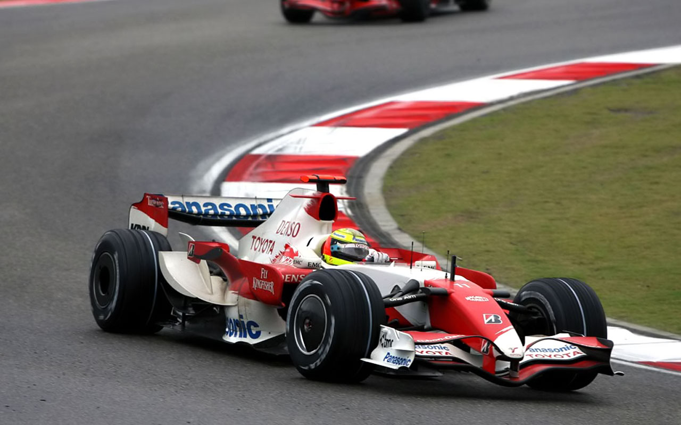
Lightweight Driver Material

Slide 13
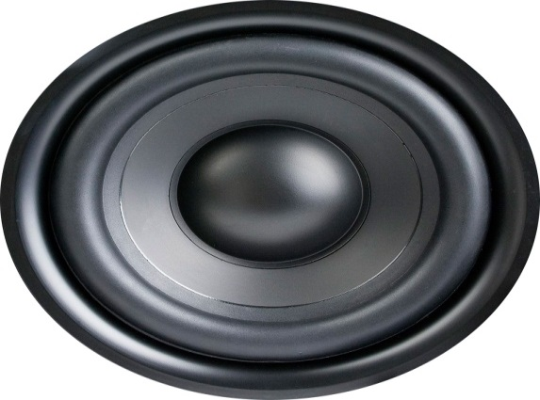
Lightweight Driver Material
2 important traits of a high performance driver:
Lightweight
&
Rigid
WHY?

Slide 14
Lightweight Driver Material
2 important traits of a high performance driver:
Lightweight:
The lighter a driver is, the faster and more accurately it can react to the source signal it is being asked to reproduce.
The result? A more detailed and accurate sound.

Slide 15
Lightweight Driver Material
Conventional “cone” or “dome” speaker
This cone driver is unable to follow the audio signal perfectly due to ”lag”
Audio “lag” smears details found in the original master recording

Slide 16
Lightweight Driver Material
Electrostatic Panel
MartinLogan ESL Plasma Bonded Diaphragm
12 Microns Thick (8x thinner than human hair)
Lightest material used in loudspeakers
Lighter than the actual air it is moving
No mass or inertia to overcome, resulting in pure sonic accuracy with no lag or distortion
12 Microns Thick
(.00048 Inches)
Notes:
Because it doesn’t move very far, an ESL panel is typically very large to achieve the surface area necessary for playback. With ML Xstat advances we are able to fit more playable area in a smaller space and achieve dynamics not previously known to the thin film world. Despite using hundreds of square inches of material, vastly more than a cone, the weight of the ESL panel is still considerably less.
So what else is there?

Slide 17
Lightweight Driver Material
Electrostatic Panel
Here is an example of our ESL panel, which reproduces the incoming audio signal perfectly.

Slide 18
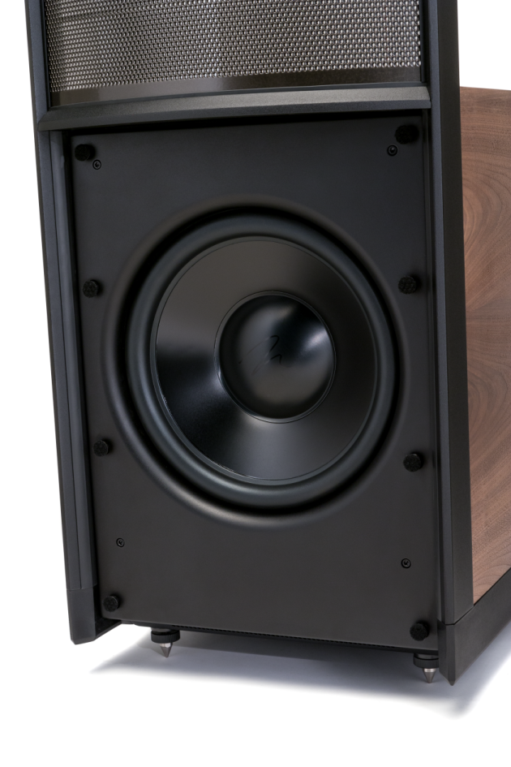
Lightweight Driver Material
MartinLogan woofer ”cone”
2 important traits of a high performance driver:
Lightweight:
MartinLogan utilizes extremely lightweight and rigid “cone” driver materials across our product line to avoid distortion or “lag”
Aluminum is one of our most popular materials for this application.
Notes:
Aluminum has a very high breakup frequency and gives us very consistent and high quality results across our product line. In more exotic products like the Neolith we also will utilize materials like Carbon Fiber for specific woofer applications.
Now…let’s take it to the extreme!

Slide 19
Linear and Uniform Movement
Notes:
Another way to further reduce distortion.

Slide 20
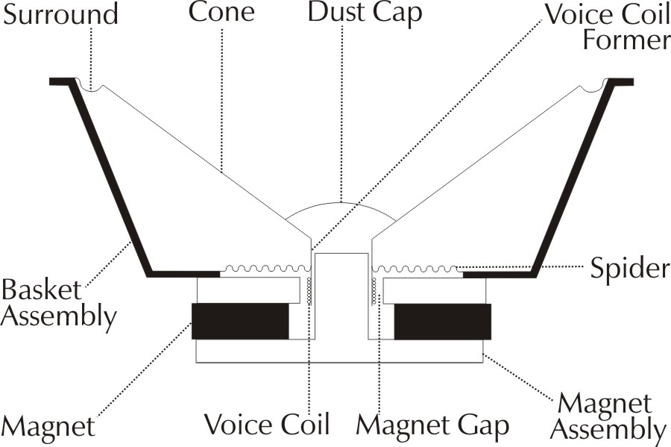
Linear and Uniform Movement
Conventional cone/dome drivers
All Cone/dome drivers are pushed from a single point
When this motion is not perfectly linear, distortion or damage can occur
Notes:
Demo pushing on a leather ottoman or similar by “drawing” a circle with your finger then pushing your finger in the center of that circle. The material will ripple. This helps visualize cone distortion as described above.
What does MartinLogan do about this?

Slide 21
Linear and Uniform Movement
Conventional cone/dome drivers
Notice how the shape of the cone changes when in motion
When a cone loses it’s initial shape, distortion occurs

Slide 22
Linear and Uniform Movement
Electrostatic Panel
A MartinLogan XStat ESL panel is not driven from a single point.
It’s entire surface is driven uniformly. Reducing any motion induced surface distortion.

Slide 23
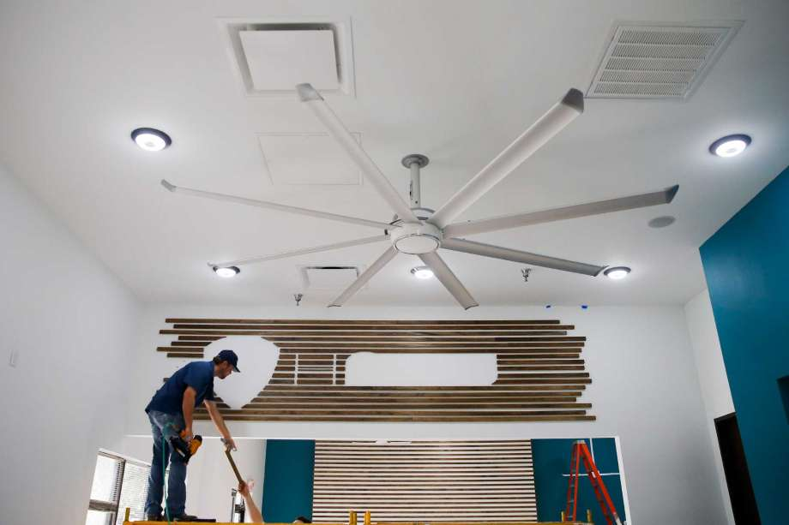
Large Surface Area
Notes:
By utilizing a large surface area, ESL is able to more efficiently move air. This drastically reduces distortion and allows the panel to not only play loudly with minimal effort but also very quietly. This Large surface area design in the ESL panel effectively creates a Line Source. Losing considerably less volume at distance.

Slide 24
Large Surface Area
Conventional Floor Speaker
Electromotion ESL
1” Dome Tweeter .79 in²
6” Midrange Driver 28 in²
292 in² 34” x 8.6” Xstat Panel
6.5” Woofer 33 in²
6.5” Woofer 33 in²
50 in² 8” Woofer
Total Sound Radiating Area
95 in² VS 342 in²
Notes:
By utilizing a large surface area, ESL is able to more efficiently move air. This drastically reduces distortion and allows the panel to not only play loudly with minimal effort but also very quietly. This Large surface area design in the ESL panel effectively creates a Line Source. Losing considerably less volume at distance.

Slide 25
Achieving ”Truth In Sound”
3 main speaker components
Crossover
Notes:
Discuss the basic function of a crossover and its potential for causing distortion or coloration into the signal path.

Slide 26
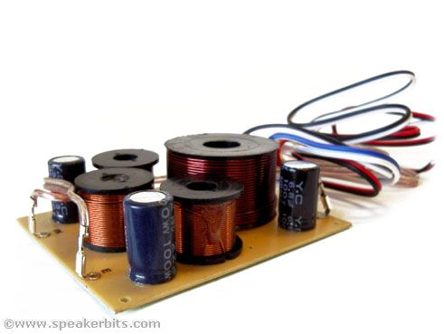
Lack of Crossover (Critical Zone)
Notes:
Again, emphasize “less is more.” Getting rid of sources of distortion brings the customer closes to their content! “truth in sound!”

Slide 27
Lack of Crossover (Critical Zone)
Conventional Floor Speaker
Frequency Range: 2khz-20khz
Conventional speaker designs require at least 1 crossover point, typically in the “Critical Zone.”
The transition between tweeter and midrange is especially critical.
Frequency Range: 400khz-2Khz
Critical Zone: 450hz-20khz
Notes:
By utilizing a large surface area, ESL is able to more efficiently move air. This drastically reduces distortion and allows the panel to not only play loudly with minimal effort but also very quietly. This Large surface area design in the ESL panel effectively creates a Line Source. Losing considerably less volume at distance.

Slide 28
Lack of Crossover (Critical Zone)
Conventional Floor Speaker
Frequency Range: 2khz-20khz
The goal of needed crossover design in boxed speakers is to use increasing parts quality to reduce these inevitable distortions.
Frequency Range: 400khz-2Khz
Critical Zone: 450hz-20khz
Notes:
By utilizing a large surface area, ESL is able to more efficiently move air. This drastically reduces distortion and allows the panel to not only play loudly with minimal effort but also very quietly. This Large surface area design in the ESL panel effectively creates a Line Source. Losing considerably less volume at distance.

Slide 29
Lack of Crossover (Critical Zone)
Conventional Floor Speaker
Frequency Range: 2khz-20khz
Adding these necessary parts in the crossover creates new problems while solving existing ones, creating a never-ending cycle.
Meaning the “best crossover” is still coloring the signal.
Frequency Range: 400khz-2Khz
Critical Zone: 450hz-20khz
Notes:
By utilizing a large surface area, ESL is able to more efficiently move air. This drastically reduces distortion and allows the panel to not only play loudly with minimal effort but also very quietly. This Large surface area design in the ESL panel effectively creates a Line Source. Losing considerably less volume at distance.

Slide 30
Lack of Crossover (Critical Zone)
Conventional Floor Speaker
Frequency Range: 2khz-20khz
What is the only way to completely eliminate these colorations or distortions in the crossover?
Frequency Range: 400khz-2Khz
Critical Zone: 450hz-20khz
Notes:
By utilizing a large surface area, ESL is able to more efficiently move air. This drastically reduces distortion and allows the panel to not only play loudly with minimal effort but also very quietly. This Large surface area design in the ESL panel effectively creates a Line Source. Losing considerably less volume at distance.

Slide 31
Lack of Crossover (Critical Zone)
Conventional Floor Speaker
Frequency Range: 2khz-20khz
What is the only way to completely eliminate these colorations or distortions in the crossover?
NO CROSSOVER!
Frequency Range: 400khz-2Khz
Critical Zone: 450hz-20khz
Notes:
By utilizing a large surface area, ESL is able to more efficiently move air. This drastically reduces distortion and allows the panel to not only play loudly with minimal effort but also very quietly. This Large surface area design in the ESL panel effectively creates a Line Source. Losing considerably less volume at distance.

Slide 32
Lack of Crossover (Critical Zone)
Conventional Floor Speaker
Frequency Range: 2khz-20khz
All frequencies play uniformly across the entire surface of the ESL panel
Frequency Range: 400khz-2Khz
Critical Zone: 450hz-20khz
Frequency Range: 20hz-400hz
Frequency Range: 20hz-(250-500)hz
Notes:
By utilizing a large surface area, ESL is able to more efficiently move air. This drastically reduces distortion and allows the panel to not only play loudly with minimal effort but also very quietly. This Large surface area design in the ESL panel effectively creates a Line Source. Losing considerably less volume at distance.

Slide 33
Key Benefits of ESL
Lightweight Driver Material
Linear and Uniform Movement
Large Surface Area
Lack of Crossover (Critical Zone)

Slide 34
Achieving ”Truth In Sound”
3 main speaker components
Cabinet
Notes:
Explain the basic function of a cabinet and how it needs to be extremely strong and dense so cabinet vibrations and resonances do not transfer into the speakers and cause distortion, or directly cause distortion.

Slide 35
Achieving ”Truth In Sound”
Cabinet
The best cabinets have no sound of their own and do not vibrate or resonate.
Cabinet resonance and vibrations can also be transferred into the drivers themselves.
Guess what else has no sound of its own and prevents resonance and vibration from distorting the driver?
Notes:
Explain the basic function of a cabinet and how it needs to be extremely strong and dense so cabinet vibrations and resonances do not transfer into the speakers and cause distortion, or directly cause distortion.

Slide 36
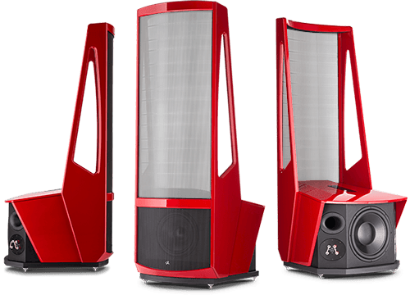
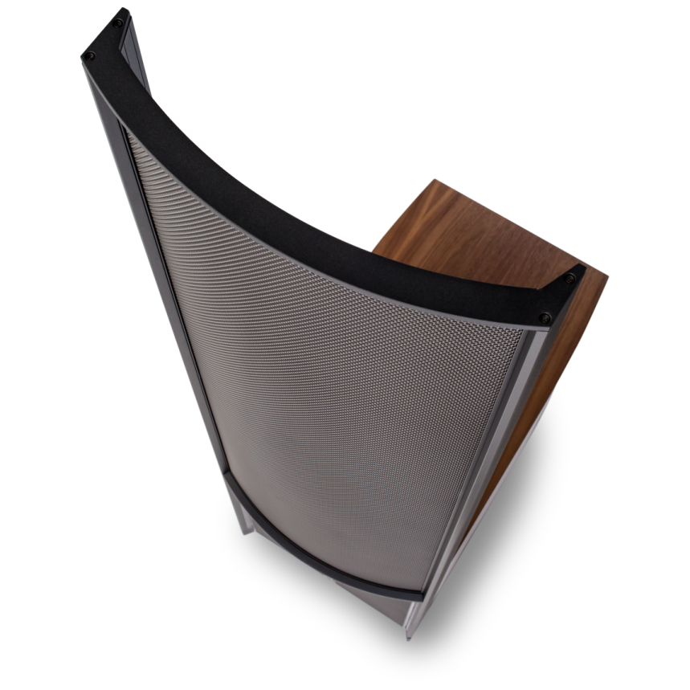
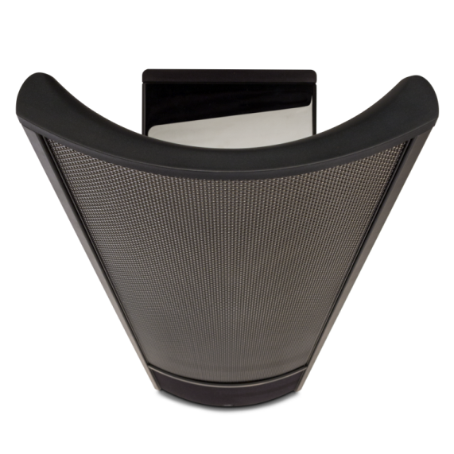
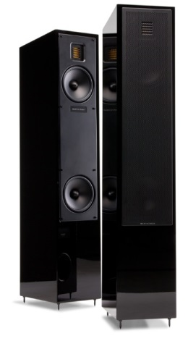
Achieving ”Truth In Sound”
Cabinet
NO CABINET!
Notes:
Getting rid of the cabinet of the speaker in favor of the space age AirFrame and AirFrame Blade eliminates any resonance or distortion from the cabinet. The best sounding cabinets have no sound, having no cabinet has no sound too!

Slide 37
Achieving ”Truth In Sound”
Cabinet
Notes:
Getting rid of the cabinet of the speaker in favor of the space age AirFrame and AirFrame Blade eliminates any resonance or distortion from the cabinet. The best sounding cabinets have no sound, having no cabinet has no sound too!

Slide 38
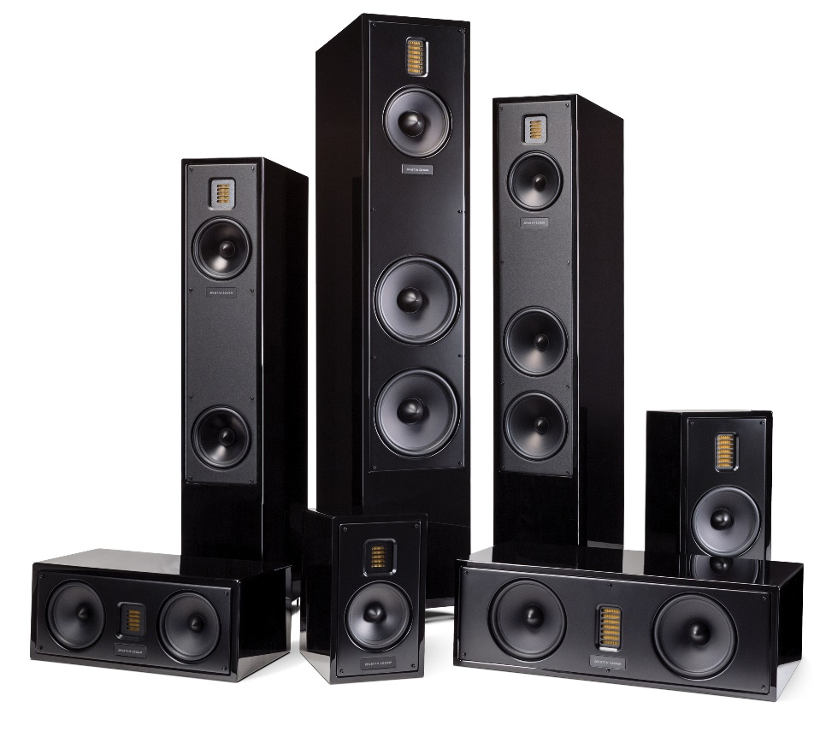
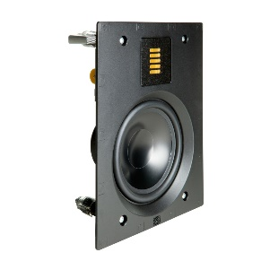
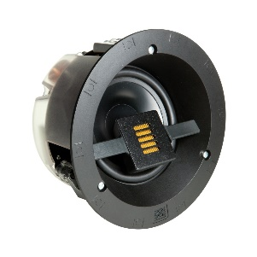
What if…
…you could design a driver that shares many of the same benefits of an ESL?
…that driver could be engineered considerably smaller than an ESL?
…that driver could be utilized in almost any application?
Turns out, it exists! We call it…

Slide 39
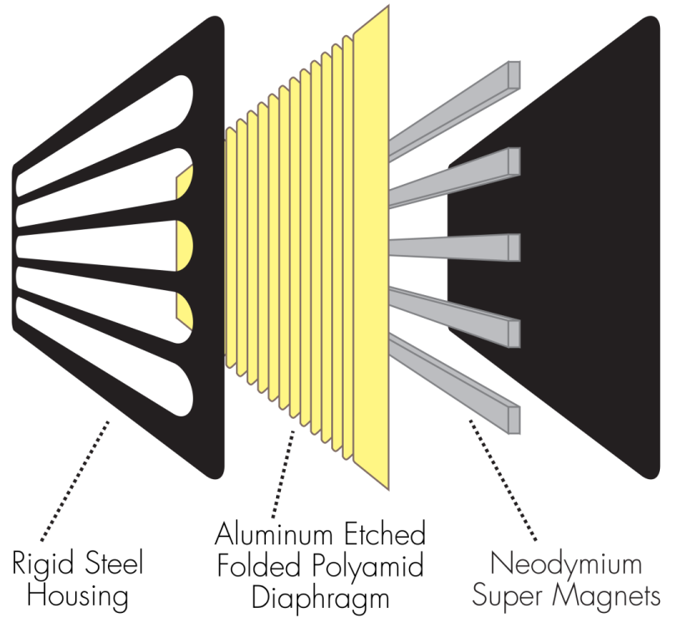
Folded Motion Tweeter (FMT)
Extremely lightweight material with at least 7x more surface area than a 1-inch dome tweeter
FMT "squeezes" air instead of pushing air
Lightning fast response time, requiring 90% less excursion than a 1-inch dome tweeter, drastically minimizing distortion
Wide and controlled sound dispersion to create a realistic and precise soundstage
Notes:
FMT offers many of the benefits of ESL in a much smaller and more affordable package. Especially good for applications where an ESL isn’t practical, FMT is perfectly suited for matching up with ESL speakers.

Slide 40
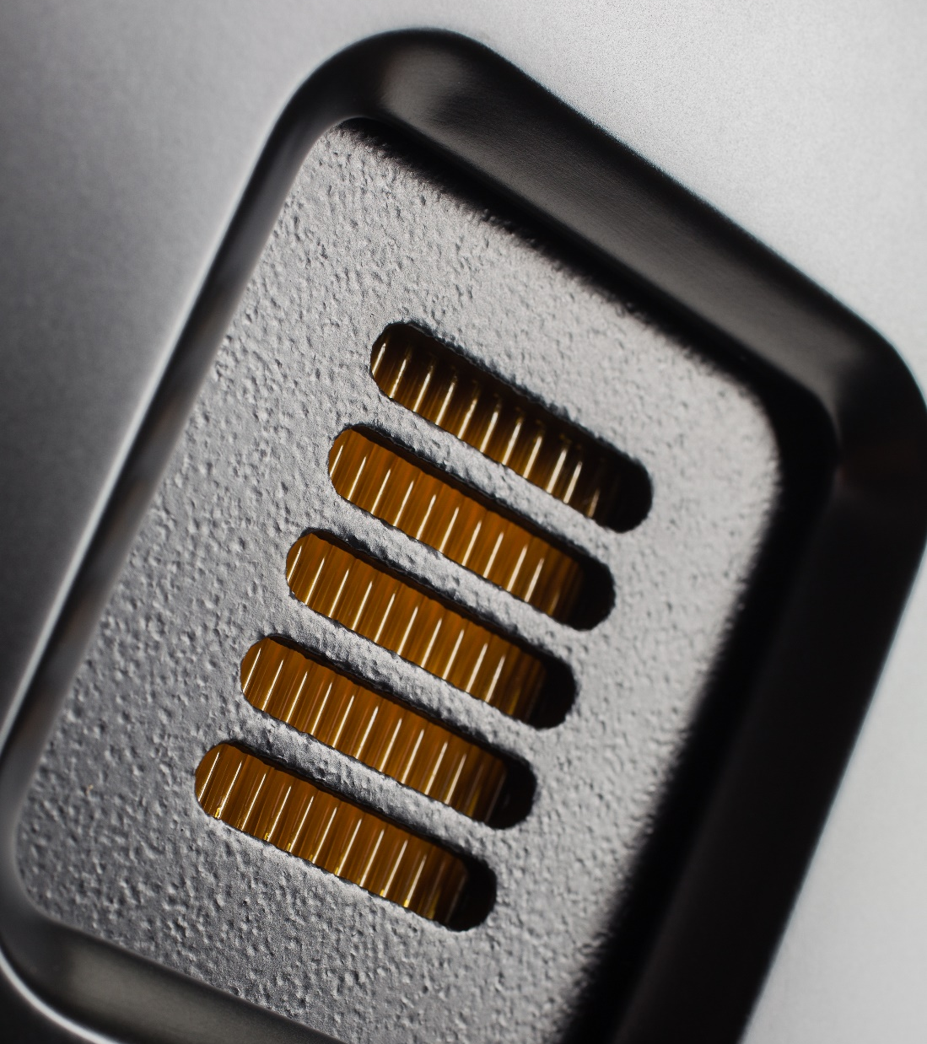
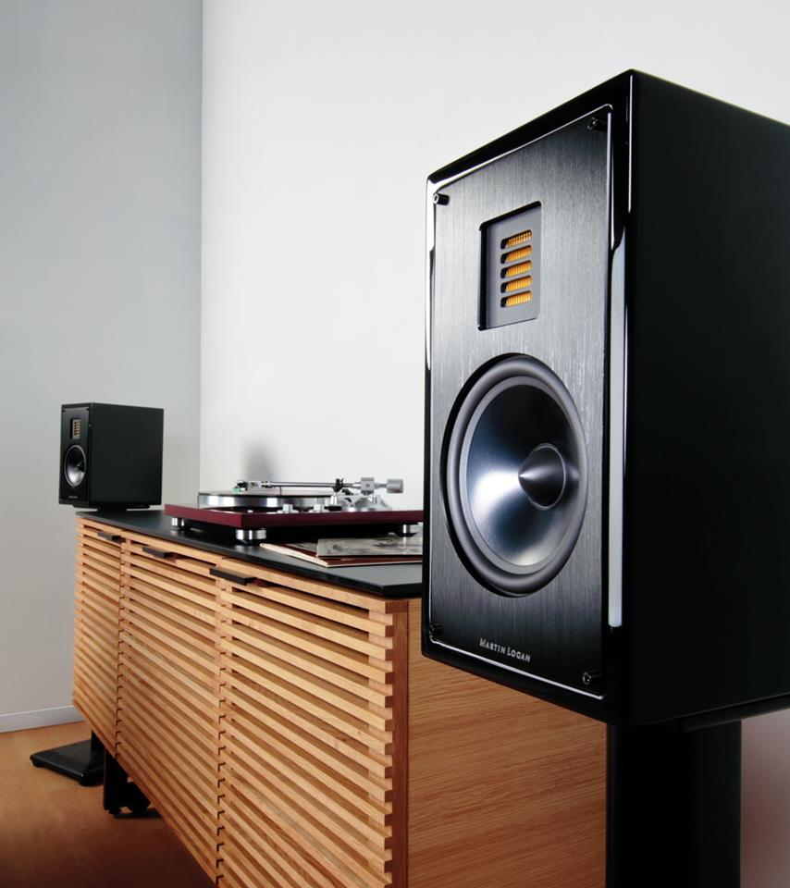
The Magic of Motion
The FMT is the heart of the Motion series. An extremely lightweight driver, sharing many of the benefits of ESL, mated with high performance woofers inside high quality, premium cabinets.
Folded Motion Tweeter

Slide 41
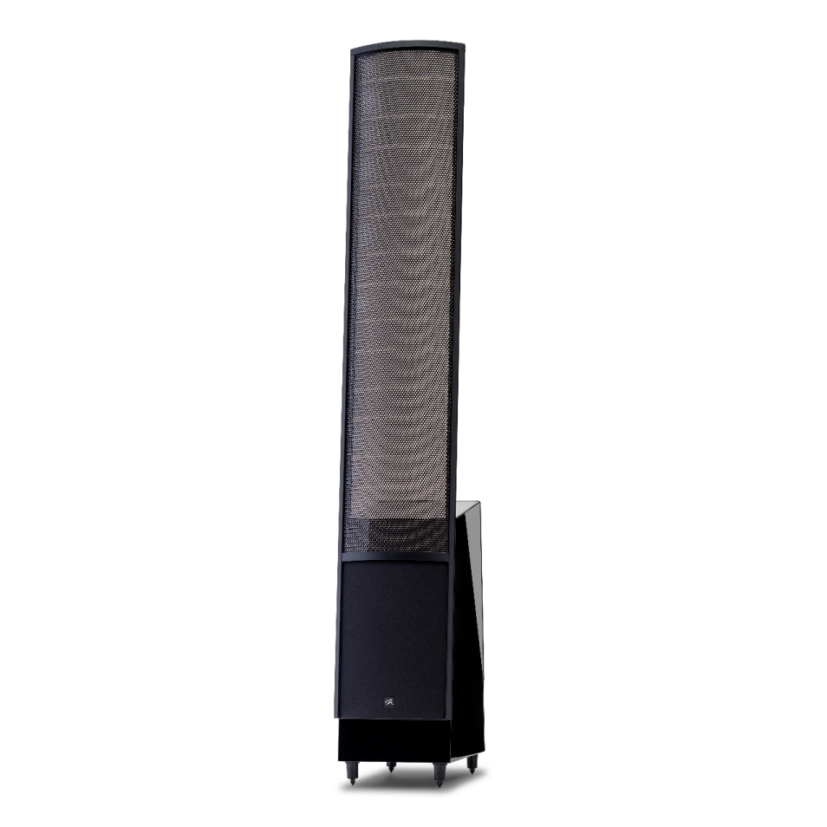
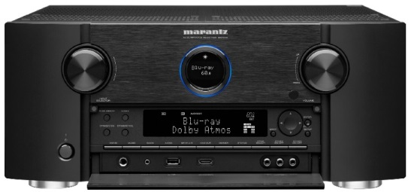
Ingredients for a great sound system

Slide 42
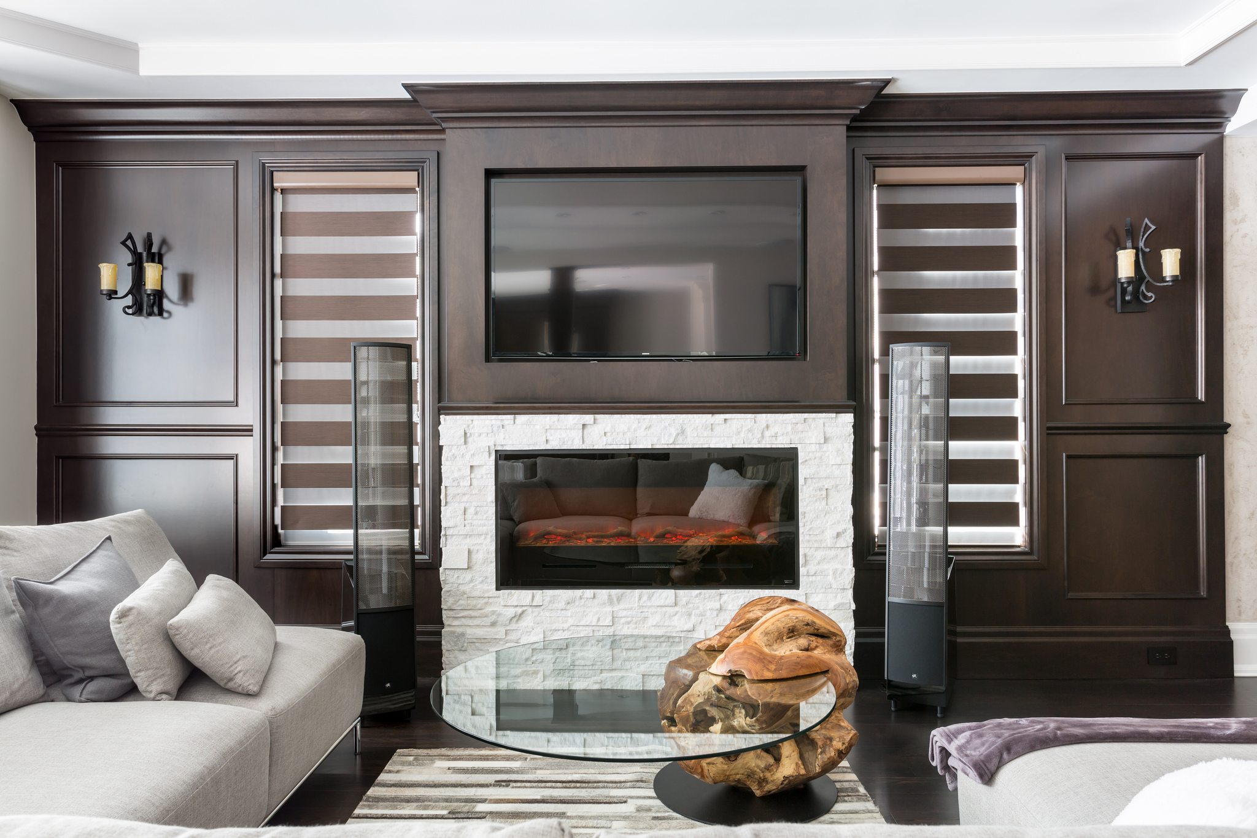
Overall experience
What factors into this?

Slide 43
Overall experience
What factors into this?
“Take bad room acoustics out of the equation!”

Slide 44
Controlled Dispersion
Controlled Dispersion
Notes:
Emphasize reflections impacting the sound by cupping your hands to your mouth or placing your hand above, below and to the sides to simulate a wall. Better yet, use a real wall!

Slide 45
Conventional Speakers (Cone/Dome)
Wide-Dispersion (180º x 180º )
Acoustic issues:
Less direct sound and more reflected sound
Blurry imaging and soundstage
Muddy midrange sound and bloated or anemic bass
Sound radiates nearly 180 degrees horizontally out from the front of the speaker
Notes:
Emphasize reflections impacting the sound by cupping your hands to your mouth or placing your hand above, below and to the sides to simulate a wall. Better yet, use a real wall!

Slide 46
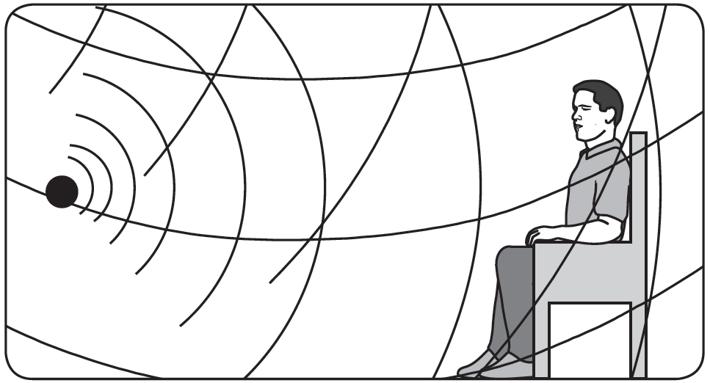
Conventional Speakers (Cone/Dome)
Wide-Dispersion (180º x 180º )
Acoustic issues:
Floor Bounce
Ceiling Bounce
Negative impact on vocal intelligibility
Sound radiates nearly 180 degrees vertically out from the front of the speaker
Notes:
Emphasize reflections impacting the sound by cupping your hands to your mouth or placing your hand above, below and to the sides to simulate a wall. Better yet, use a real wall!

Slide 47
MartinLogan Controlled Dispersion
Electrostatic and Folded Motion Technology
Focused and controlled sound to the listeners ears before any room reflections occur.
Notes:
Emphasize reflections impacting the sound by cupping your hands to your mouth or placing your hand above, below and to the sides to simulate a wall. Better yet, use a real wall!

Slide 48
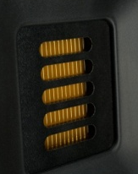
Controlled Dispersion Comparison
By the numbers…
Folded Motion Tweeter (80º x 80º) Controlled, wide sweet spot.

Slide 49
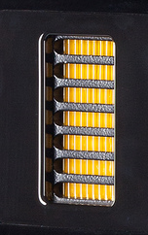
Controlled Dispersion Comparison
By the numbers…
Folded Motion XT (80º x 30º) Controlled, wide sweet spot with better vertical control.

Slide 50
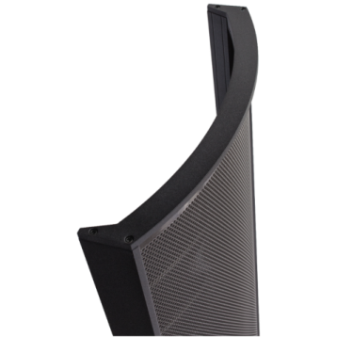
Controlled Dispersion Comparison
By the numbers…
Electrostatic (30º x Panel Height & Angle) Most focused, least room interaction. Allows very flexible and forgiving placement in any room!

Slide 51
Controlled Dispersion Comparison
By the numbers…
Folded Motion (80º x 80º) Controlled, wide sweet spot.
All three technologies integrate seamlessly.
Folded Motion XT (80º x 30º) Controlled, wide sweet spot with better vertical control.
Electrostatic (30º x Panel Height & Angle) Most focused, least room interaction. Allows very flexible and forgiving placement in any room!

Slide 53
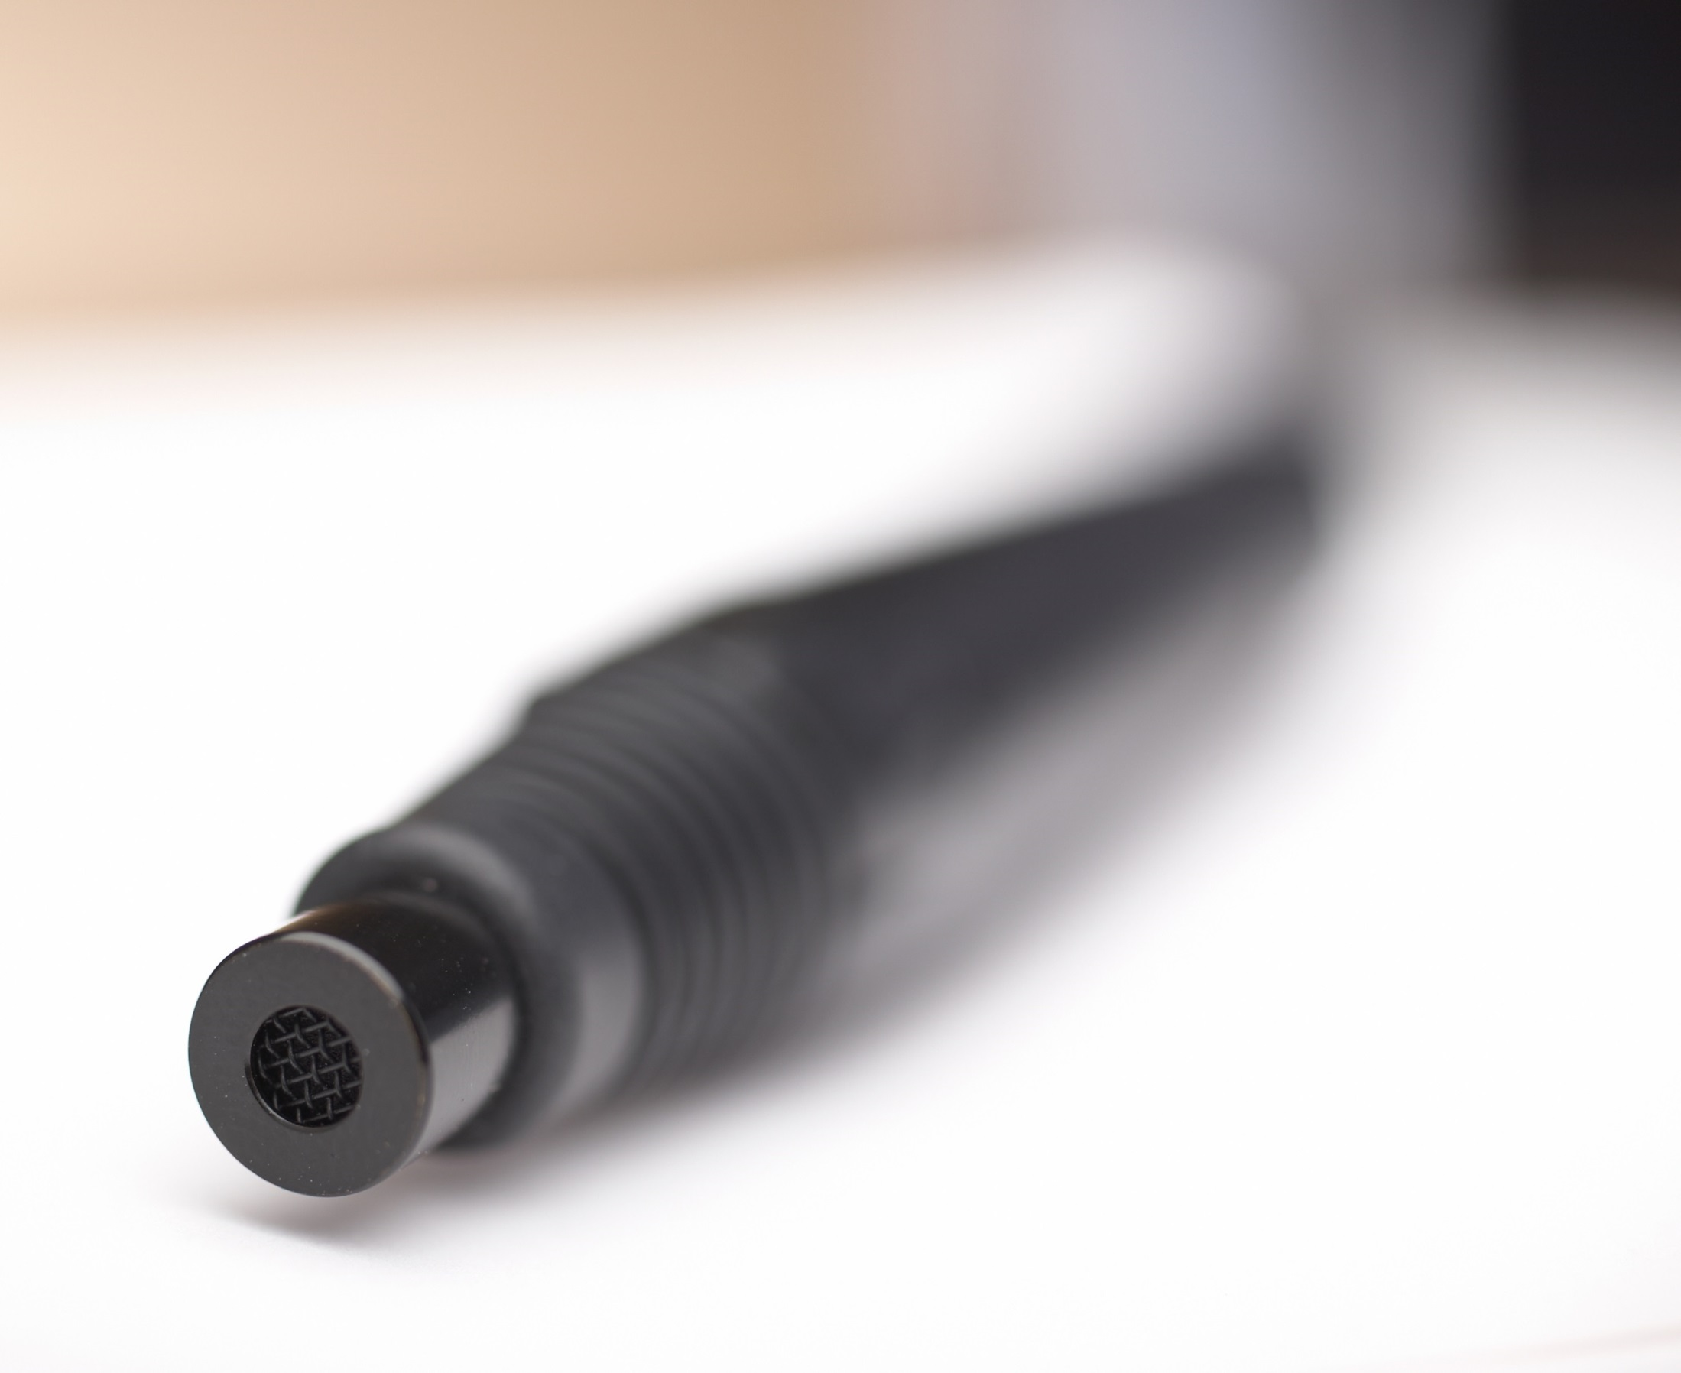

Slide 54
ARC/PBK
Room correction
ARC/PBK is included in several MartinLogan products ranging from sound bars to tower speakers.
Masterpiece series speakers and select Dynamo/Balanced Force subwoofers utilize application specific measurements specifically targeting bass frequencies in order to measure and smooth out bass nodes and nulls.

Slide 55
ARC/PBK
Room correction
Unlike some other systems available, ARC/PBK also measures and retains the room gain (the naturally occurring bass in the room) keeping the end result from sounding thin and anemic. People leave it turned on!

Slide 56
ARC/PBK
Room correction
ARC keeps the parts of your room that sound good, and fixes the parts that don’t!

Slide 57
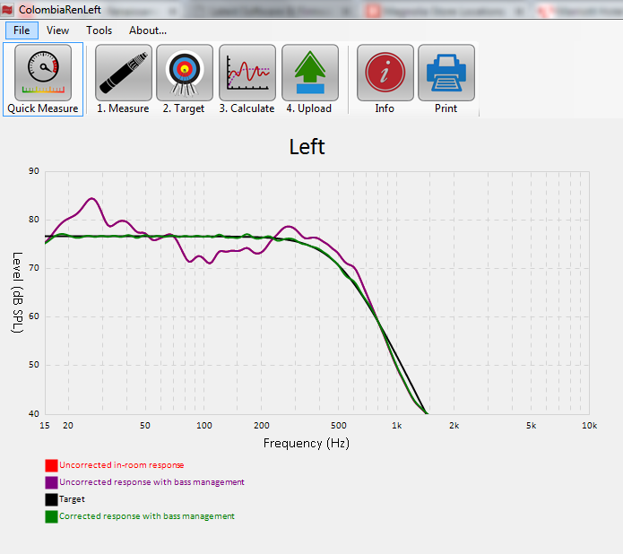
ARC/PBK
Room Correction
In ARC/PBK are custom tailored for MartinLogan applications to correct room anomalies for maximum low end fidelity.
Seamless bass performance in actual rooms, not just in a lab scenario.
The controlled dispersion ESL panel coupled with PoweredForce Forward and ARC technologies allow the top Masterpiece models to achieve stunning levels of detail and nuance without room induced colorations and distortions. Allowing you closer to the absolute Truth In Sound than ever before.

Slide 58
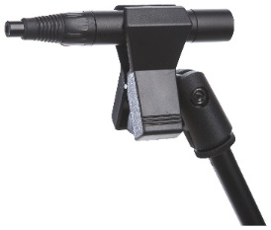
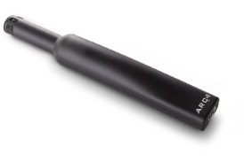
ARC/PBK
Microphone options…
Full ARC/PBK kit (includes stand and USB cables) Used for Masterpiece Series or PBK enabled subwoofers.
Requires ARC or PBK software to be installed on PC.
ARC for Play-Fi (includes USB cable) Used for Wireless Ensemble products.
Requires ARC software to be installed on PC or iOS (requires CCK).
ARC Mobile (iOS and Android) Used with wireless ensemble and 2018 Dynamo X products. Tune your speakers with any iOS or Android device.

Slide 59
ARC/PBK
Room Correction
Renaissance ESL 15A in acoustically treated room.

Slide 60
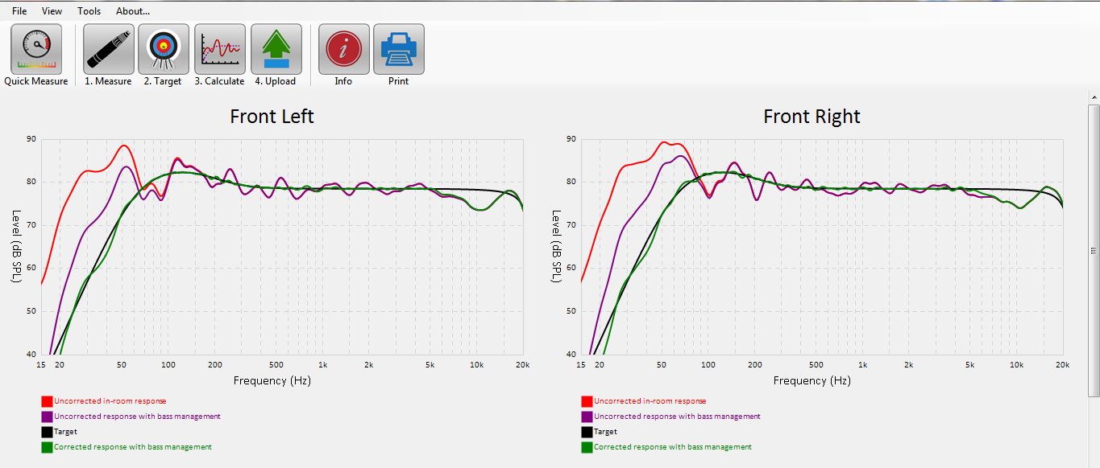
ARC/PBK
MartinLogan Forte powering Motion60XT in a small room.

Slide 61
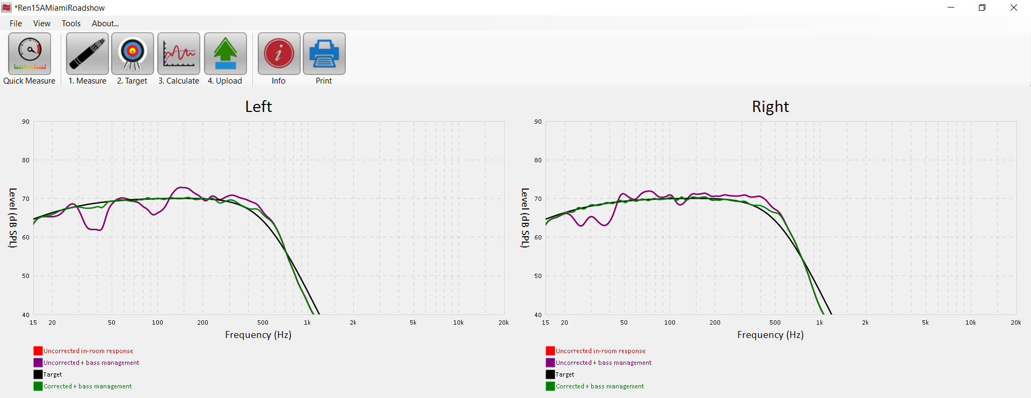
ARC/PBK
Renaissance ESL 15A in hotel ballroom.

