Slide 1
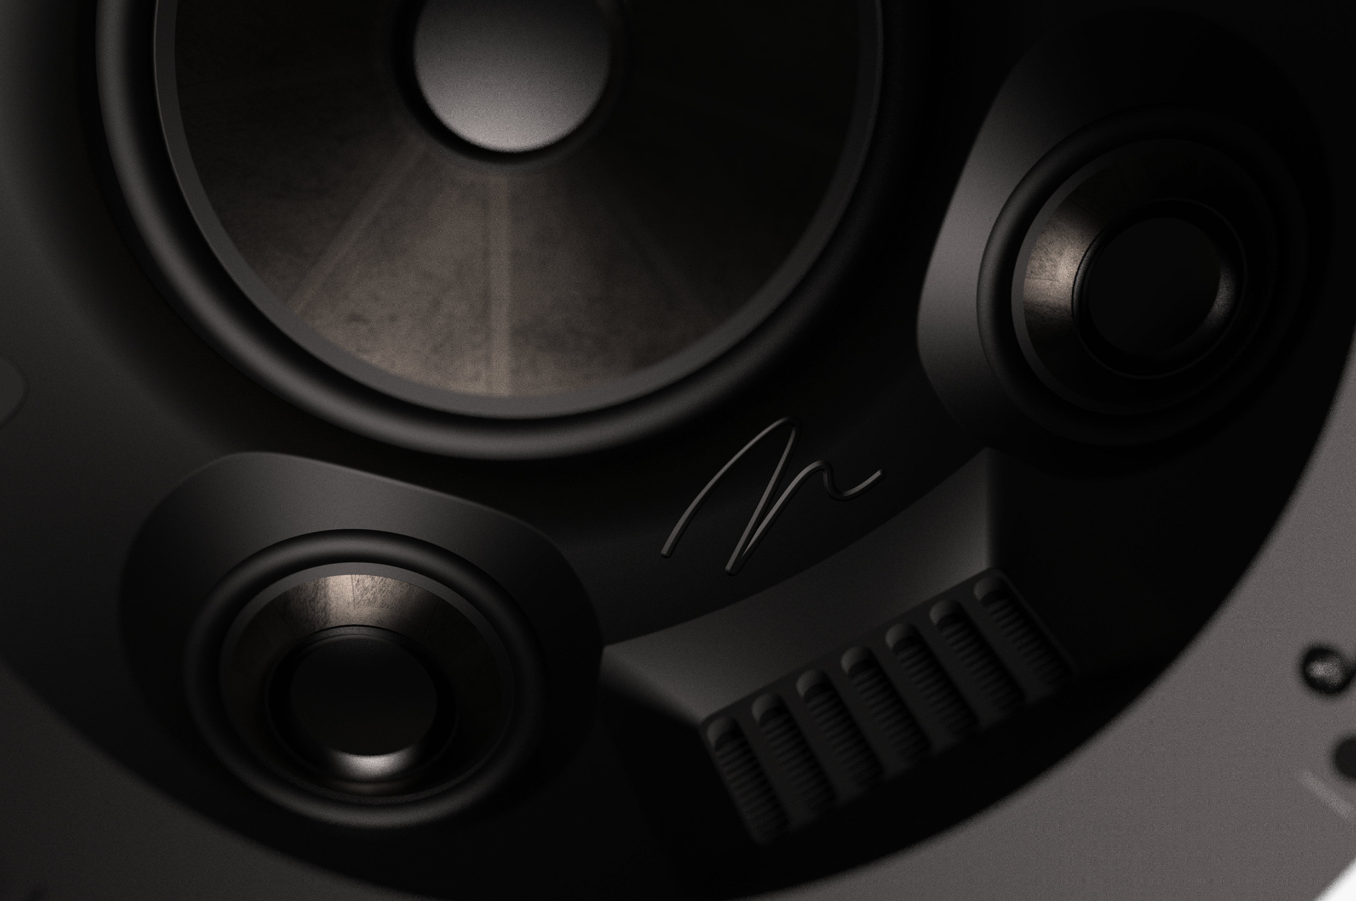
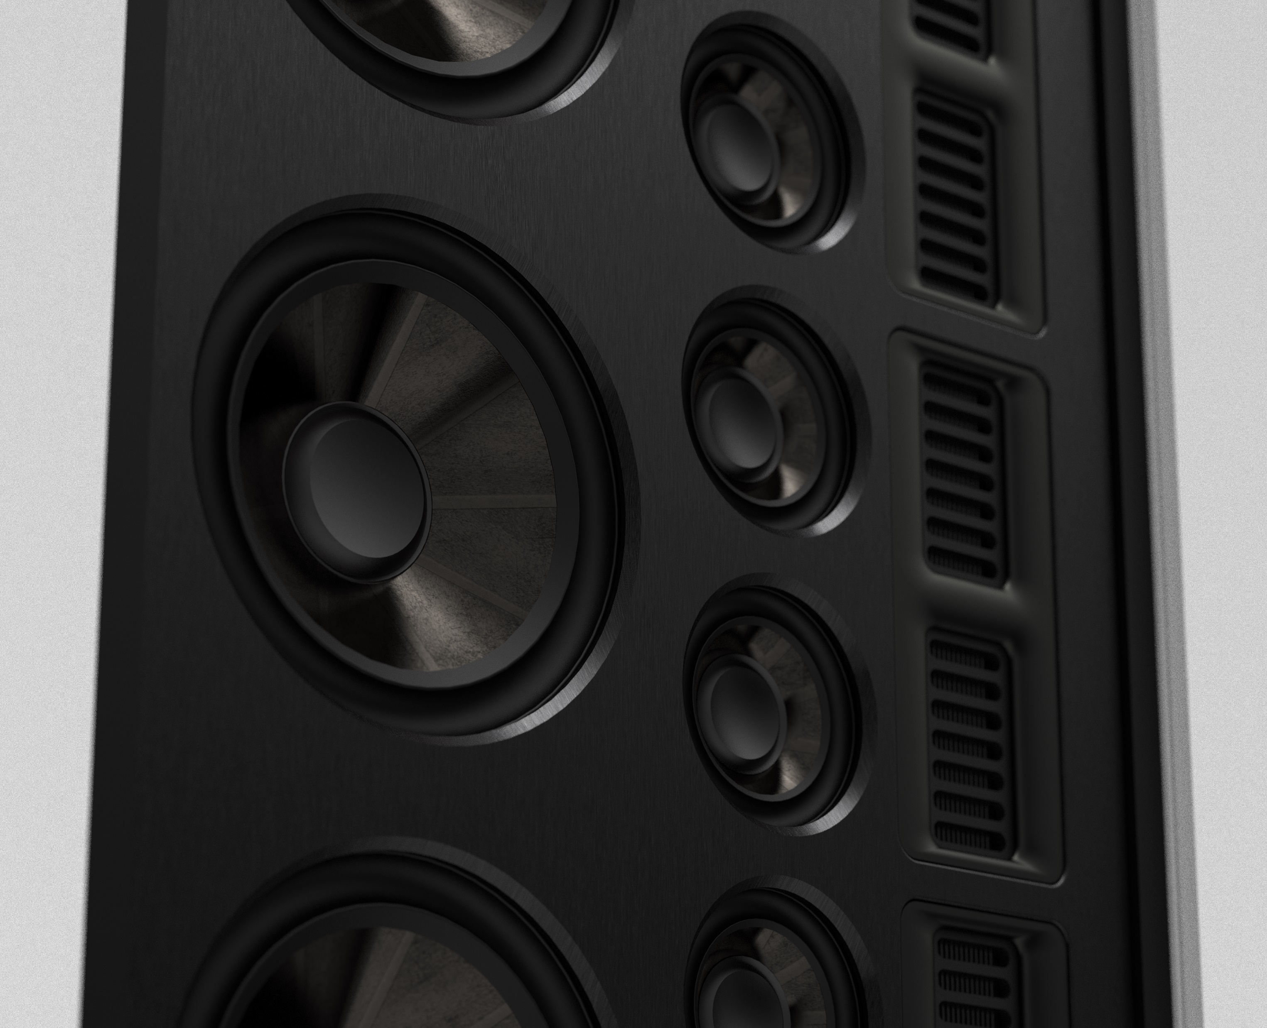
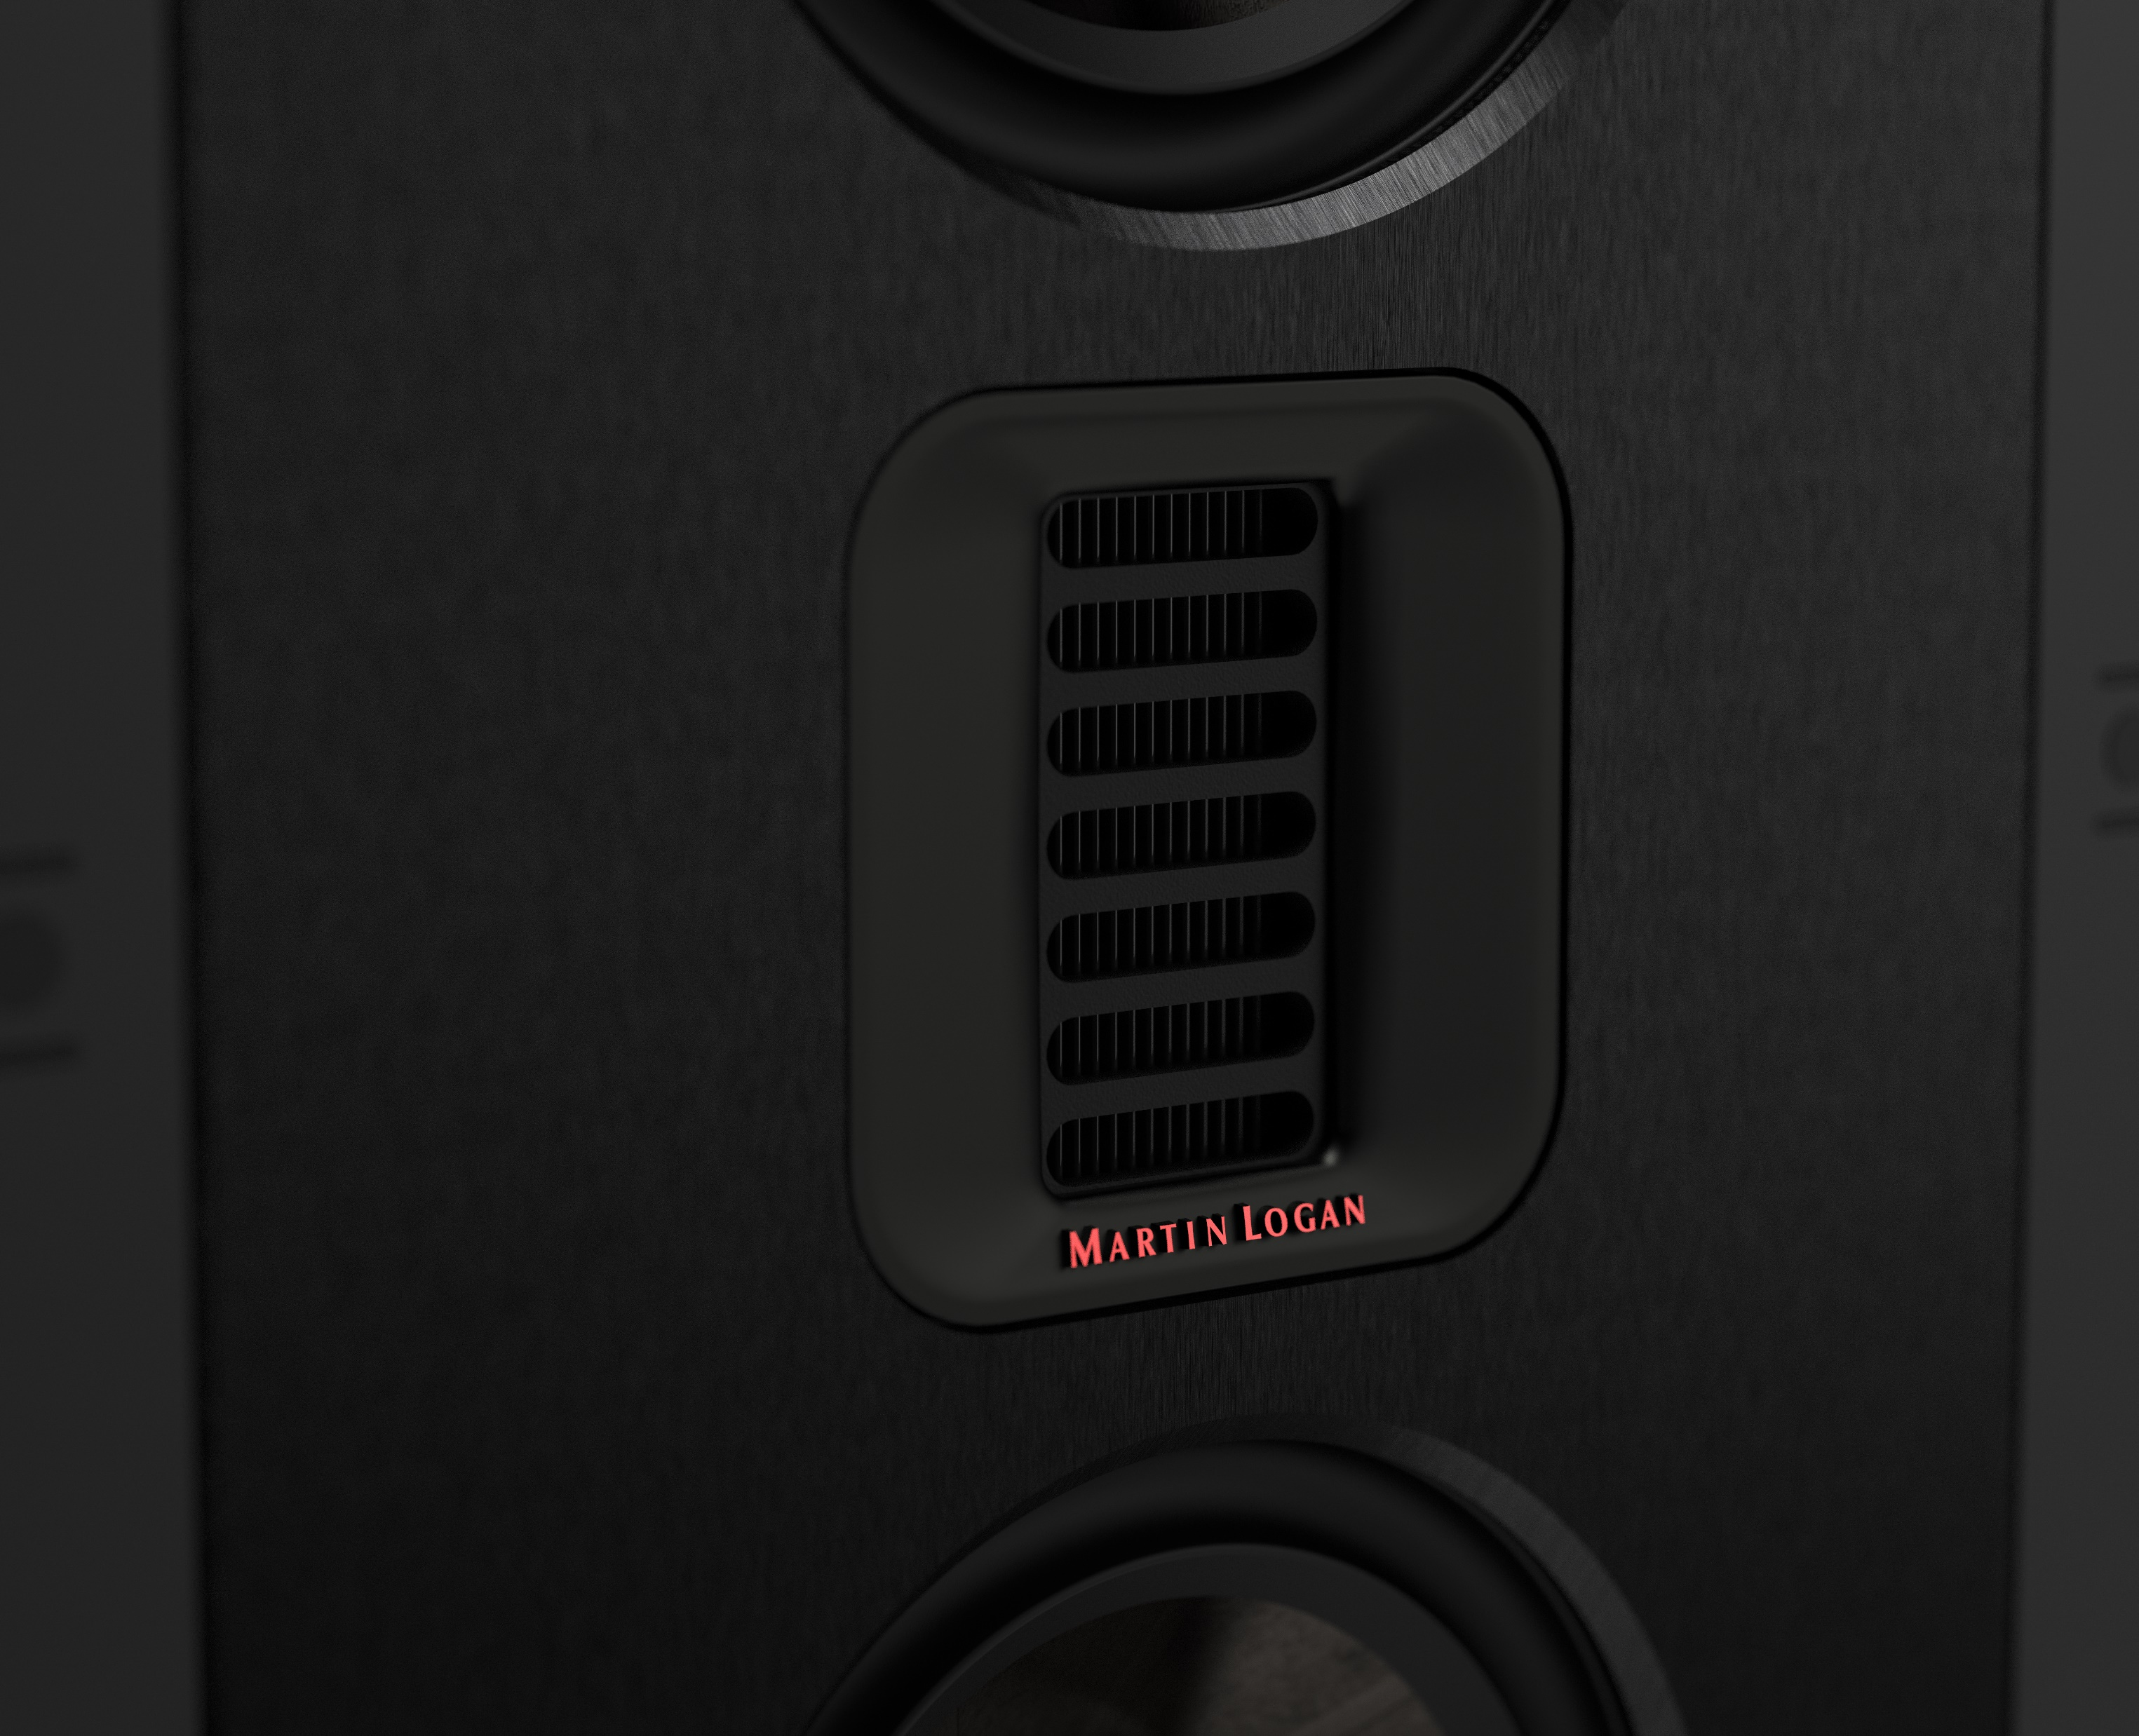

Slide 2
New Masterpiece CI Series
Feature Summary
Folded Motion Tweeter XT Obsidian
Unidirectional Carbon Fiber, Multi Section Cones w/ Nomex backer
Phenolic Front Baffles (In-Wall Models)
Brushed Aluminum Faceplate Trim (In-Wall Models)
Precision Vojtko Crossover Networks
Sealed Back Box Enclosures (All Models)

Slide 3
New Masterpiece CI Series
Folded Motion Tweeter XT Obsidian
The FMT XT Obsidian is a more stealth take on the FMT XT tweeter, known for its peerless precision, detail, clarity, output and phase coherence.

Slide 4
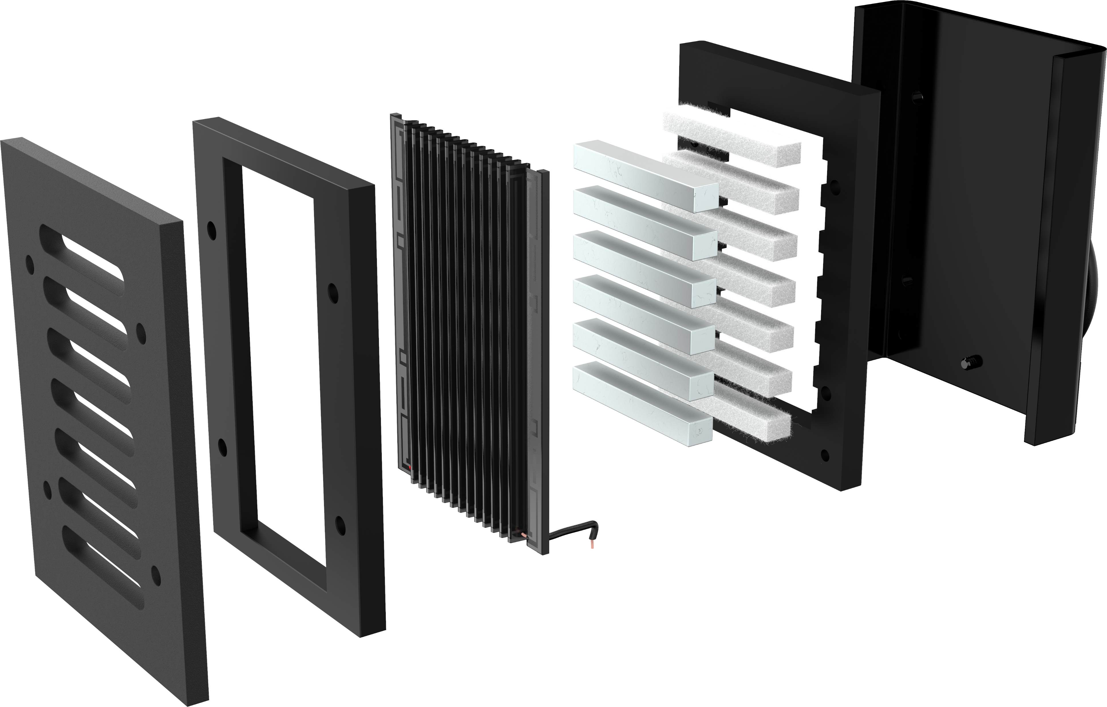
Folded Motion Tweeter (FMT XT)
The Benefits:
Extreme Light Weight: No masking of details for clearer, more accurate sound.
Larger Surface Area: Highly dynamic without any compression, for better sound quality and realism at all volume levels.
Controlled Dispersion: Provides a more direct sound onto the listeners ears for dramatically clearer sound in any environment.
Aluminum Etched Folded Polyamid Diaphragm
Neodymium Super Magnets
Rigid Steel Housing
Notes:
FMT offers many of the benefits of ESL in a much smaller and more affordable package. Especially good for applications where an ESL isn’t practical, FMT is perfectly suited for matching up with ESL speakers.

Slide 5
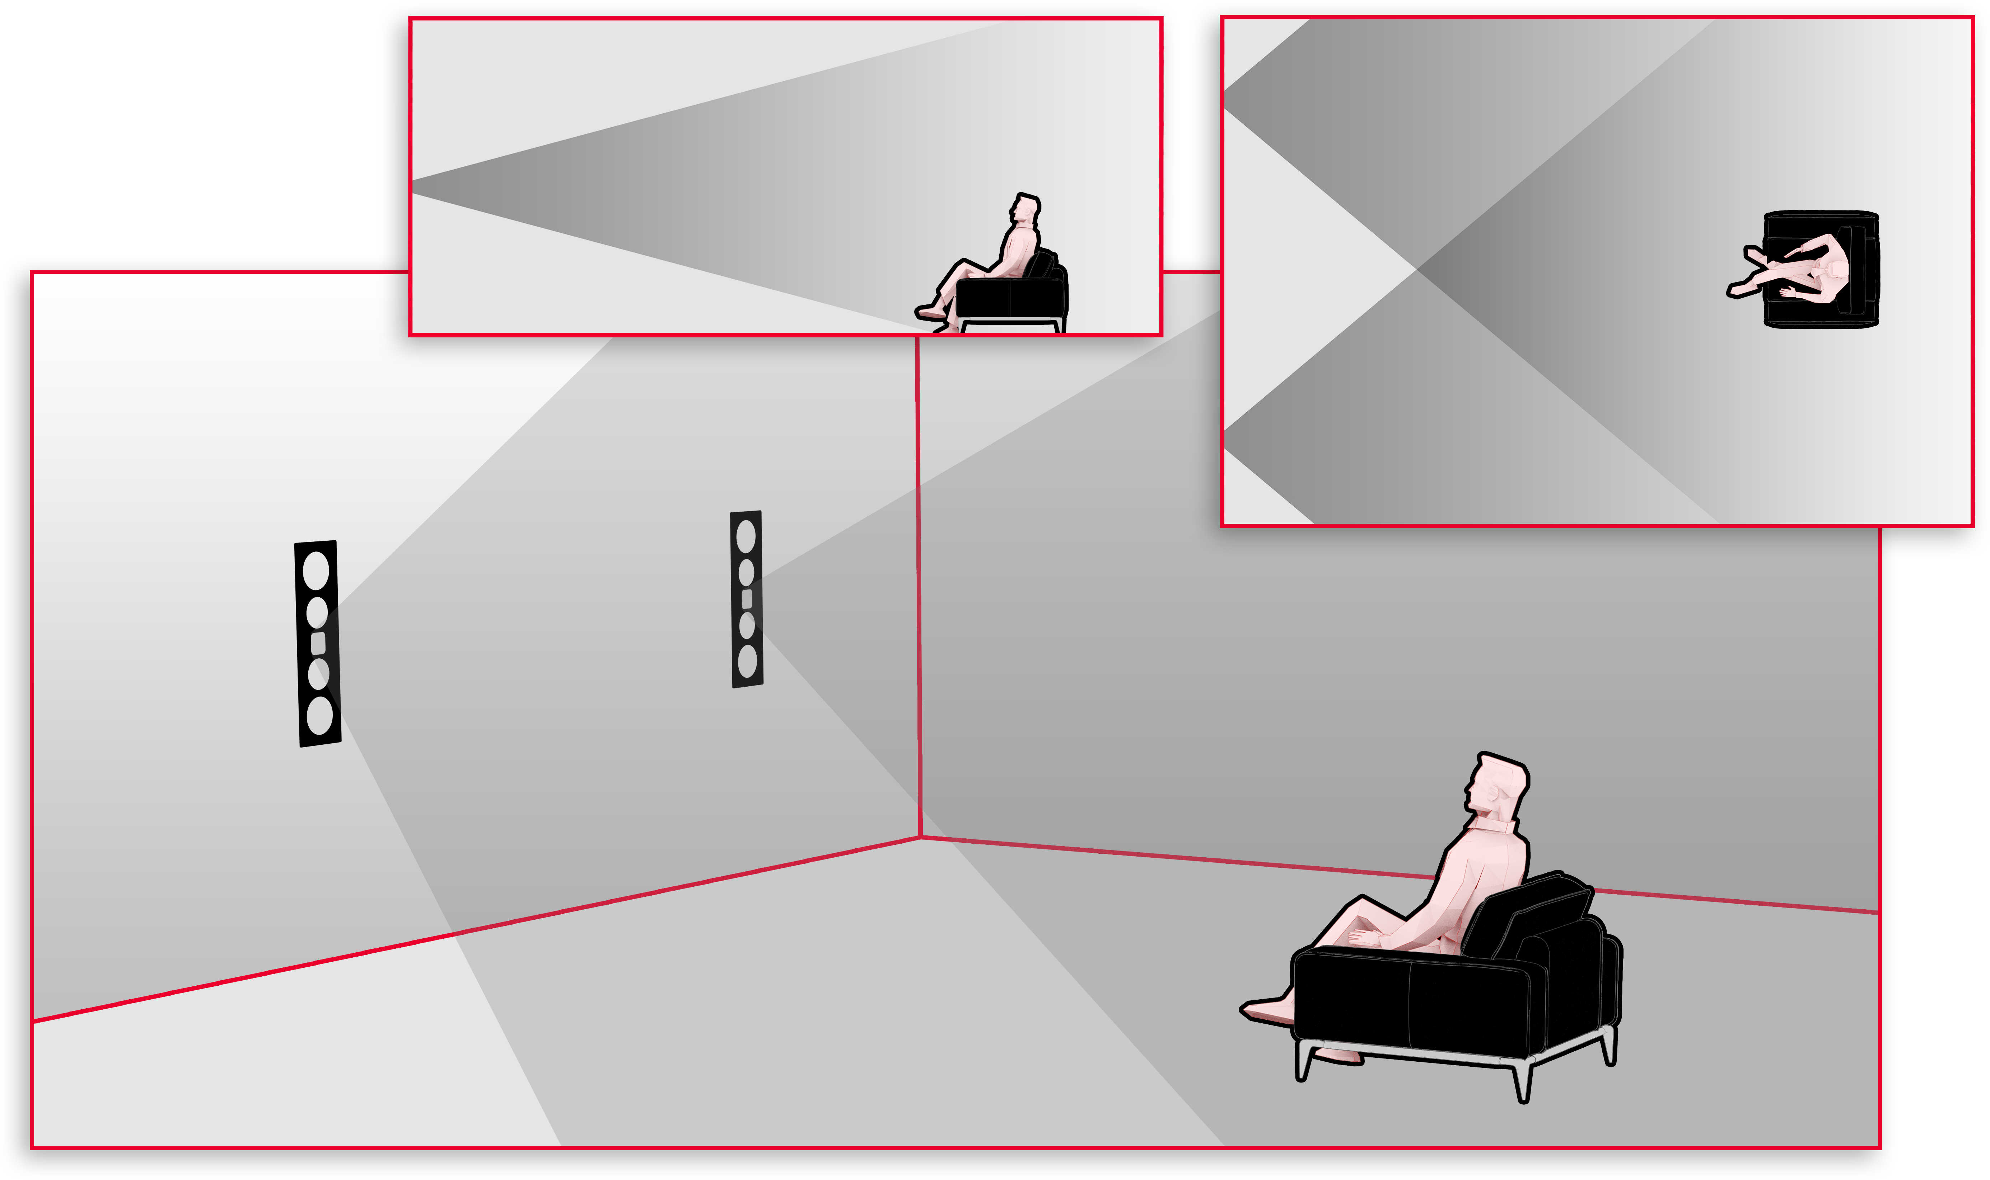
Folded Motion Tweeter (FMT XT)
FMT XT Controlled Dispersion: 80º x 30º
+ Wide dispersion to cover the listening position
+ Controlled dispersion helps avoid unwanted first reflections
+ More controlled vertical dispersion avoids negative floor and ceiling acoustic impacts
Notes:
Emphasize reflections impacting the sound by cupping your hands to your mouth or placing your hand above, below and to the sides to simulate a wall. Better yet, use a real wall!

Slide 6
New Masterpiece CI Series
Unidirectional Carbon Fiber Multi Section Cones w/ Nomex Backer
These extremely lightweight and strong drivers blend extraordinary output and dynamics with precision detail, clarity, and musicality making them ideal for both Home Theater and Music playback.

Slide 7
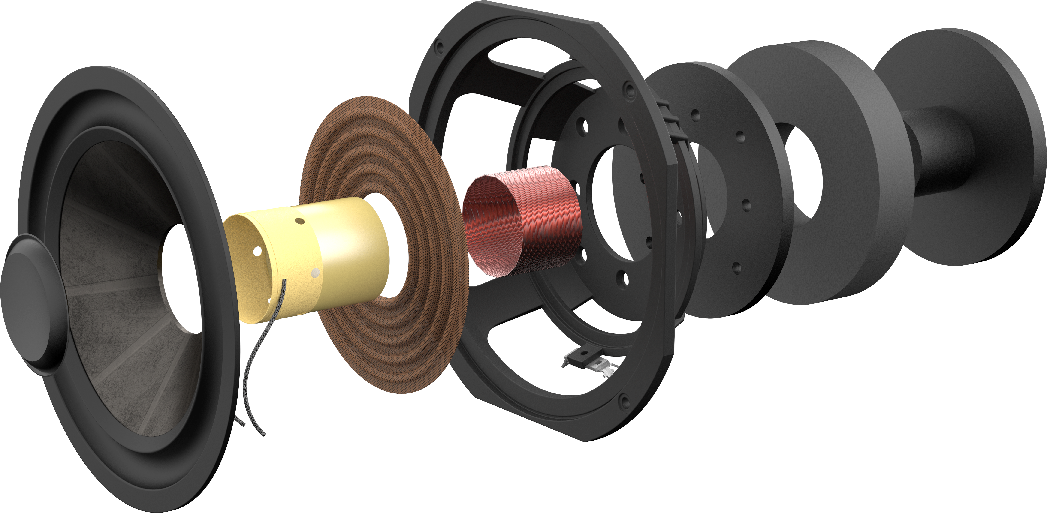
Unidirectional Carbon Fiber Cones
The Benefits:
Highly Detailed + High Output: Stronger and lighter than traditional woven carbon fiber for an ideal cone material perfectly suited for any style of content.
Consistent and Smooth: A layer of Nomex on the backside of the cone prevents unwanted resonance and ringing for better clarity and uniformity.
Pure Output: Rigid structured dust caps and an inverted surround provide a cleaner output from the cone into the room.

Slide 8
New Masterpiece CI Series
Phenolic Front Baffles
Strong and dense phenolic provides a more stable mounting platform for the high-performance drivers.

Slide 9
Phenolic Baffles
The Benefits:
Heavy, Dense, Inert: Provides a vibration free mounting platform for the drivers, allowing for the highest levels of detail.

Slide 10
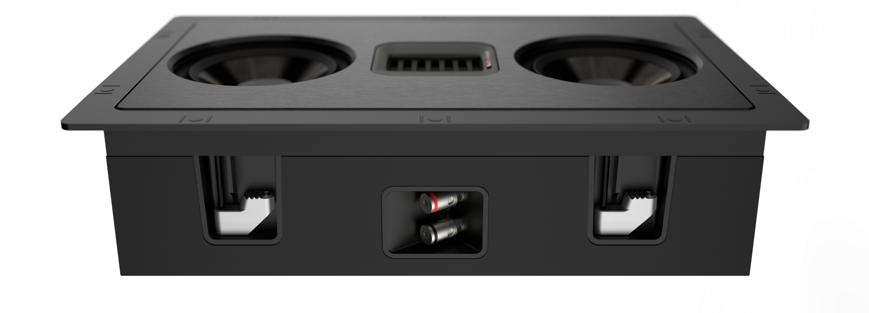
New Masterpiece CI Series
Integrated Back Boxes – Sealed Back Box Enclosures
Provides a consistent performance in any installation, while also preventing sound from “leaking” into unwanted areas of the home.

Slide 11
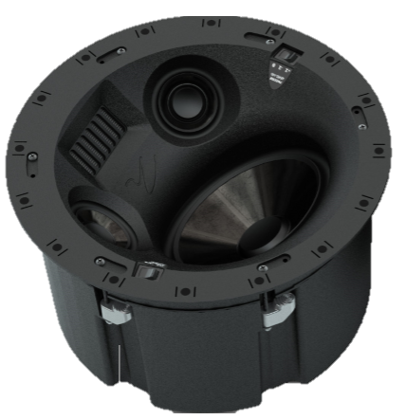
New Masterpiece CI Series
The Meaning Inside Each Name
Sistine 4XC
Application:
“C” = Ceiling
“W” = Wall
Name of Speaker:
“Sistine” = Work of Art on the Ceiling
Quantity of Drivers used in Speaker
Sistine 4XC
Icon 3XW
Tribute
5XW
Monument 7XW
Statement 40XW

Slide 12
New Masterpiece CI Series
Sistine 4XC
1x Folded Motion XT Obsidian Tweeter
2x Dedicated Midrange Drivers: 3.5”
1x Dedicated Bass Driver: 8”
Frequency Response: 63-25,000Hz ± 3dB
Sensitivity: 92dB @ 2.83 volts/meter
Impedance: 4ohms (Compatible with 4,6, or 8 ohm rated amps)
Suitable Amplifier Range: 20-300 watts
Fully Enclosed Back Box
Precision Vojtko crossover topology
Installation Position Tuning Switch
Tweeter Attenuation Switch
11.46” Cutout
7.2” Mounting Depth

Slide 13
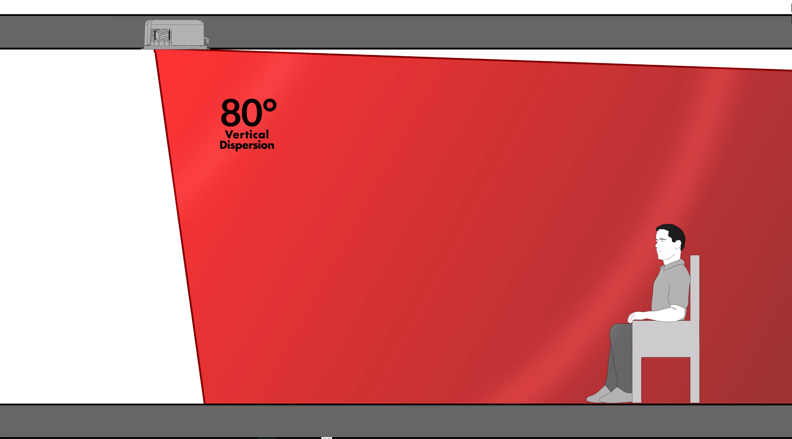
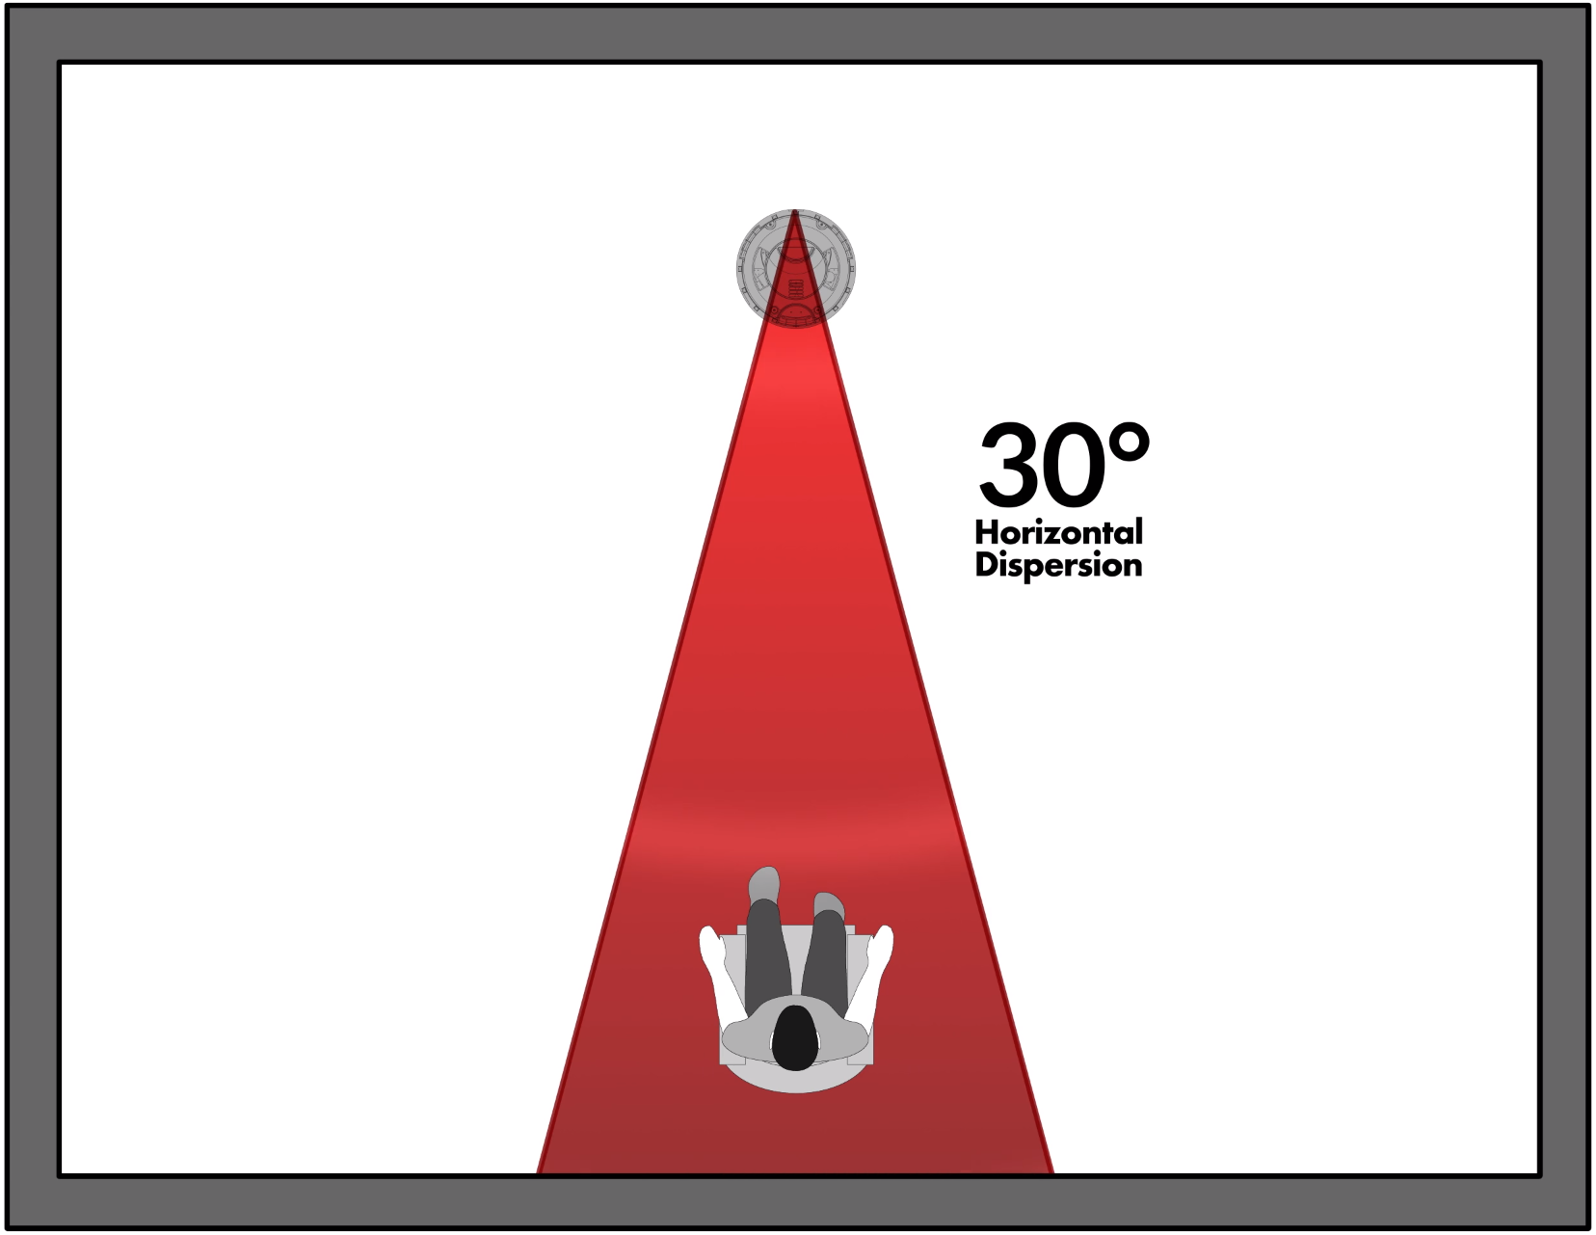
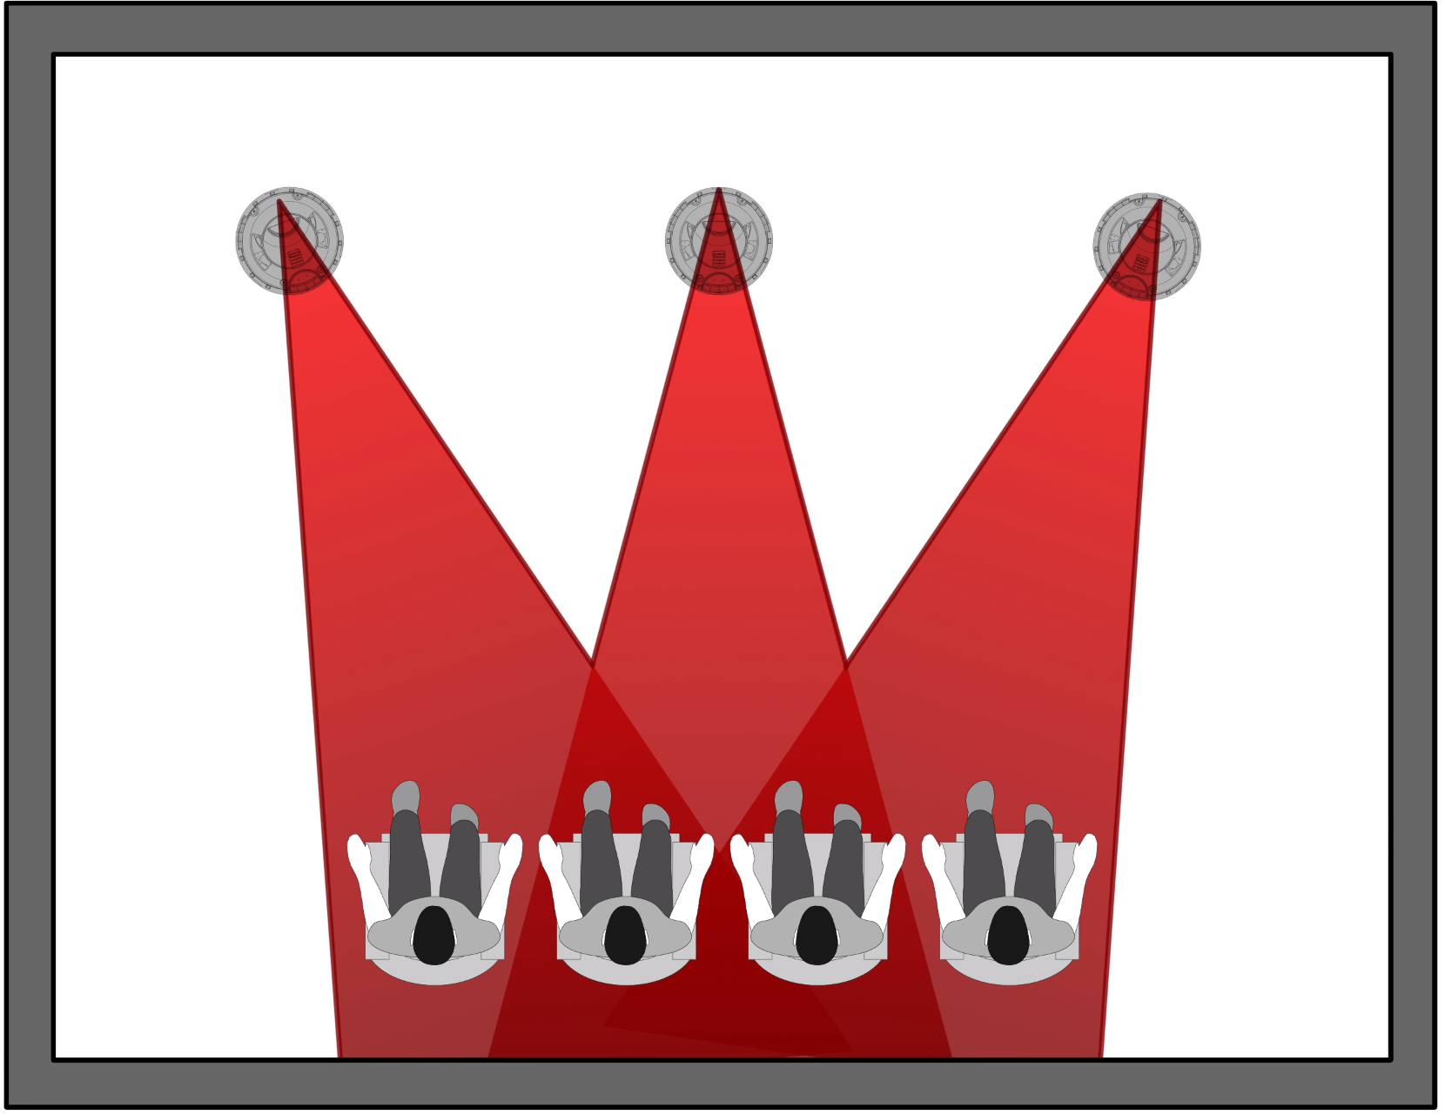
New Masterpiece CI Series
Sistine 4XC: Dispersion

Slide 14
New Masterpiece CI Series
Icon 3XW
1x Folded Motion XT Obsidian Tweeter (Rotatable)
2x Midrange/Bass Drivers: 5.5”
Frequency Response: 78-25,000Hz ± 3dB
Sensitivity: 94dB @ 2.83 volts/ meter
Impedance: 4 ohms (Compatible with 4,6, or 8 ohm rated amps)
Suitable Amplifier Range: 20-250 watts
Phenolic Front Baffle
Brushed Aluminum Faceplate
Fully Enclosed Back Box
Precision Vojtko crossover topology
14.66” x 8.64” Cutout
3.8” Mounting Depth

Slide 15
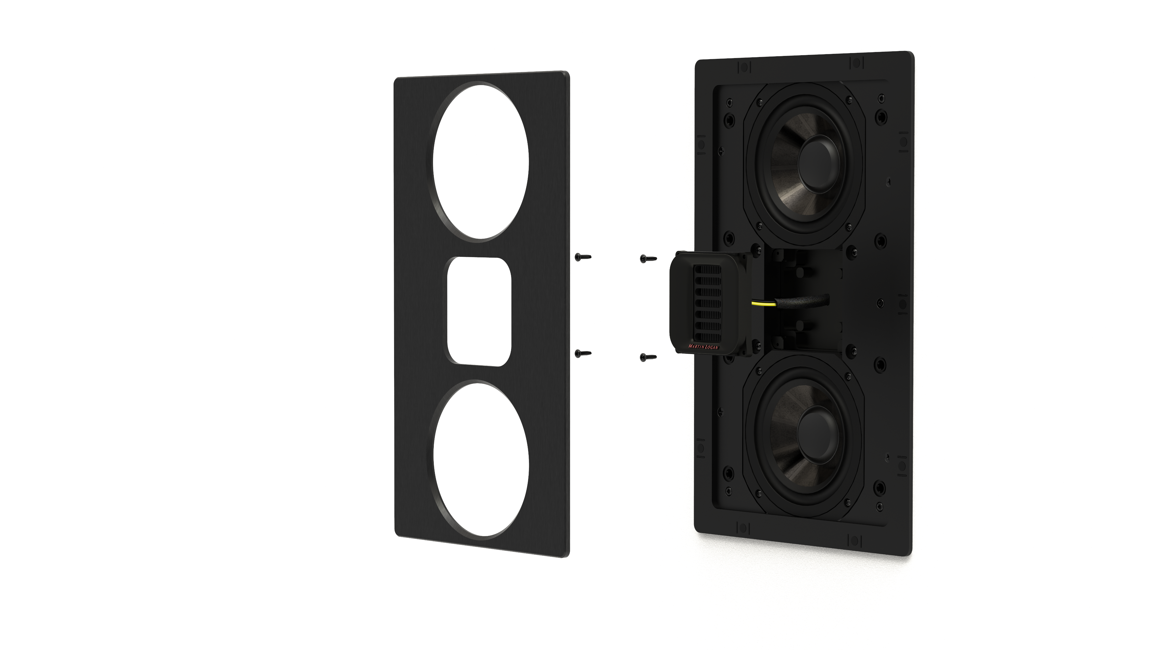
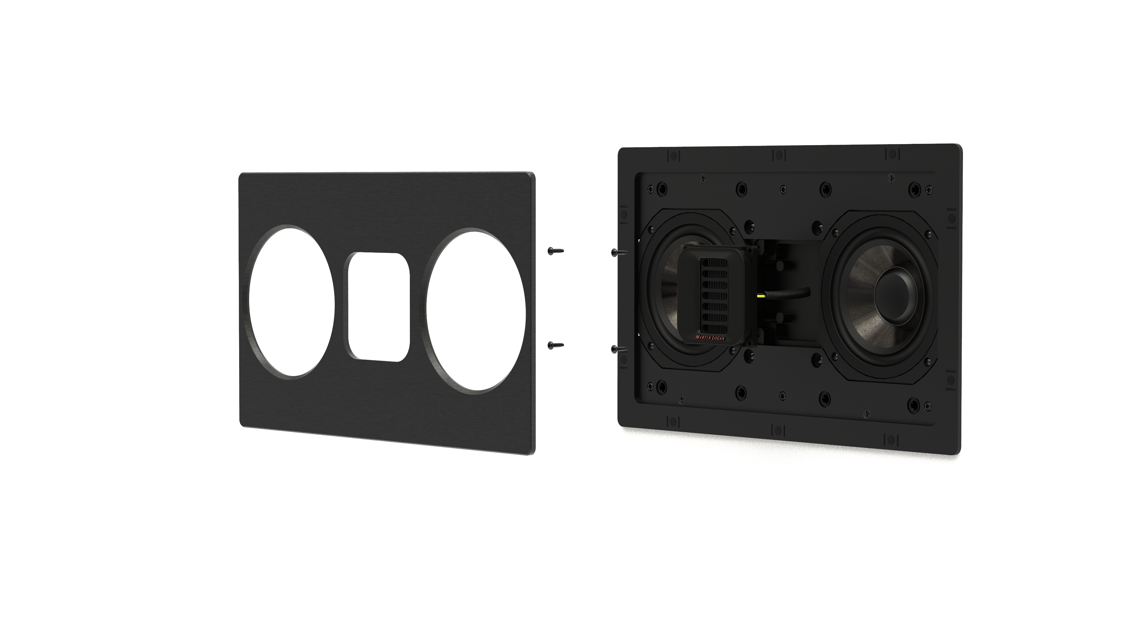
New Masterpiece CI Series
Icon 3XW, Tribute 5XW, and Monument 7XW Rotatable Tweeter
4 screws underneath the aluminum faceplate secure the tweeter.
Rotatable for optimal sound in vertical or horizontal orientations.

Slide 16
New Masterpiece CI Series
Tribute 5XW
1x Folded Motion XT Obsidian Tweeter (Rotatable)
2x Midrange/Bass Drivers: 5.5”
2x Passive Radiators: 6.5”
Frequency Response: 71-25,000Hz ± 3dB
Sensitivity: 94dB @ 2.83 volts/meter
Impedance: 4ohms (Compatible with 4,6, or 8 ohm rated amps)
Suitable Amplifier Range: 20-250 watts
Phenolic Front Baffle
Brushed Aluminum Faceplate
Fully Enclosed Back Box
Precision Vojtko crossover topology
29.82” x 9.29” Cutout
3.8” Mounting Depth

Slide 17
New Masterpiece CI Series
Monument 7XW
1x Folded Motion XT Obsidian Tweeter (Rotatable)
1x Dedicated Midrange Driver: 6.5”
2x Dedicated Bass Drivers: 6.5”
3x Passive Radiators: 6.5”
Frequency Response: 52-25,000Hz ± 3dB
Sensitivity: 95dB @ 2.83 volts/meter
Impedance: 4ohms (Compatible with 4,6, or 8 ohm rated amps)
Suitable Amplifier Range: 20-300 watts
Phenolic Front Baffle
Brushed Aluminum Faceplate
Fully Enclosed Back Box
Precision Vojtko crossover topology
45.57” x 9.29” Cutout
3.8” Mounting Depth

Slide 18
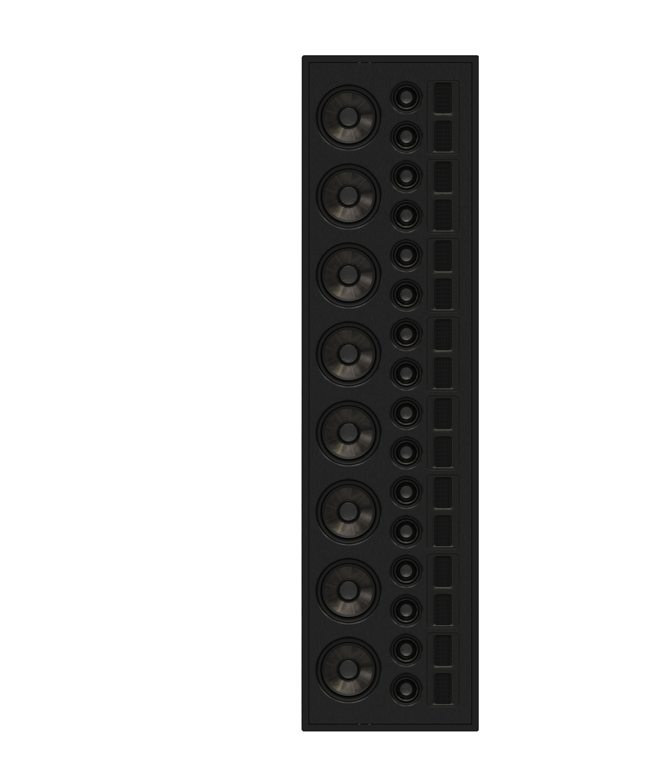
New Masterpiece CI Series
Statement 40XW
16x Folded Motion XT Obsidian Tweeters
16x Dedicated Midrange Drivers: 3.5”
8x Dedicated Bass Drivers: 6.5”
80º x 52” Line Source
Frequency Response: 48-25,000Hz ± 3dB
Sensitivity: 95dB @ 2.83 volts/meter
Impedance: 4ohms (Compatible with 4,6, or 8 ohm rated amps)
Suitable Amplifier Range: 50-800 watts
Phenolic Front Baffle
Brushed Aluminum Faceplate
Fully Enclosed Back Box
Acoustically and Mechanically Isolated Mounting Method
Precision Vojtko crossover topology
89” x 14.5” x 3.5”
Minimum Cavity

Slide 19
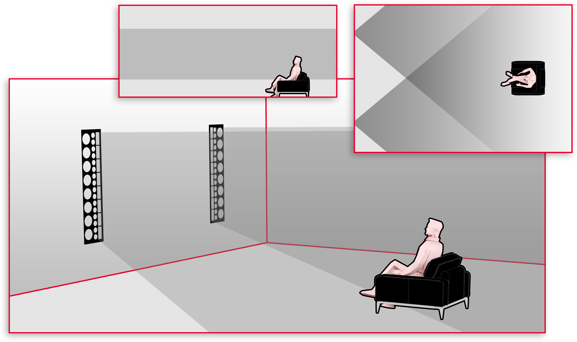
New Masterpiece CI Series
Statement 40XW Line Source Dispersion: 80º x 52”

Slide 20
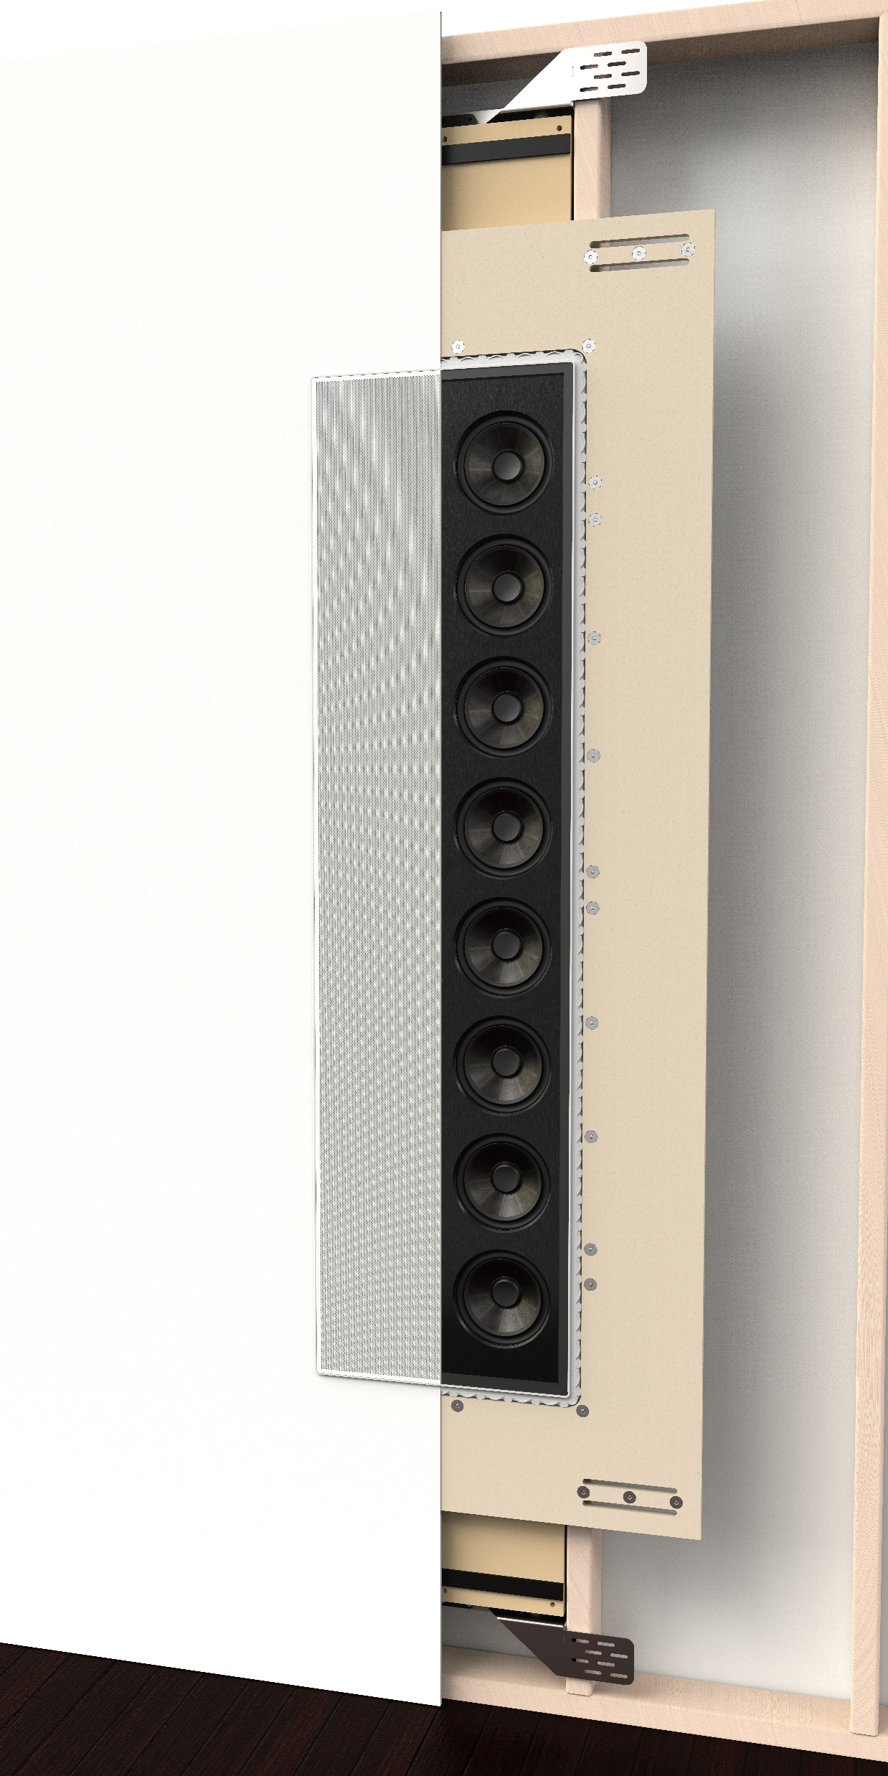
Statement 40XW In-Wall Installation
Brackets require 14.5”-16.5” width
Fiberock®
Leveling adjustments
Provides strong and consistent finish around speaker grille
Choice of 1/2” or 5/8” thickness

Slide 21
Statement 40XW In-Wall Installation
Wall surface is mated up to Fiberock®

Slide 22
Statement 40XW In-Wall Installation

Slide 23
New Masterpiece CI Series
Series | Product Name | Replacing | MSRP | Dealer Cost | Dealer Margin
Masterpiece CI | Sistine 4XC | Vanquish | $1,999/ea | $900/ea | 55 points
Masterpiece CI | Icon 3XW | NEW | $1,999/ea | $900/ea | 55 points
Masterpiece CI | Tribute 5XW | NEW | $2,999/ea | $1,350/ea | 55 points
Masterpiece CI | Monument 7XW | NEW | $4,999/ea | $2,250/ea | 55 points
Masterpiece CI | Statement 40XW | NEW | $20,000/ea | $10,000/ea | 50 points
Sistine 4XC
Icon 3XW
Tribute
5XW
Monument 7XW
Statement 40XW

Slide 24
New Masterpiece CI Series
Demo Program:
50% off sheet price
1 of each SKU every 12 months
Masterpiece CI Demo Requirements: 2 pair
Sistine 4XC
Icon 3XW
Tribute
5XW
Monument 7XW
Statement 40XW

Slide 25
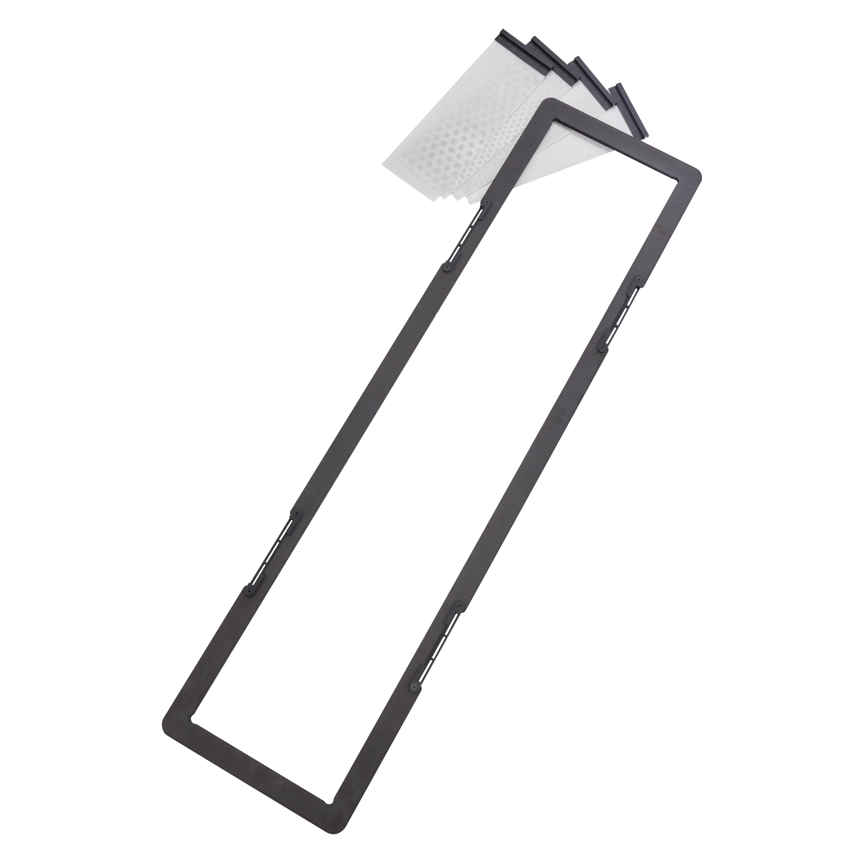
New Masterpiece CI Series
Pre-Install Brackets and Accessories
Sistine Square Grille
$25/ea
Sistine Bracket= C8HTBRK
Icon Bracket=
3XWBRK
Tribute Bracket=
5XWBRK
Monument Bracket=
7XWBRK
$25/pr
$25/pr
$100/ea
$100/ea

Slide 26
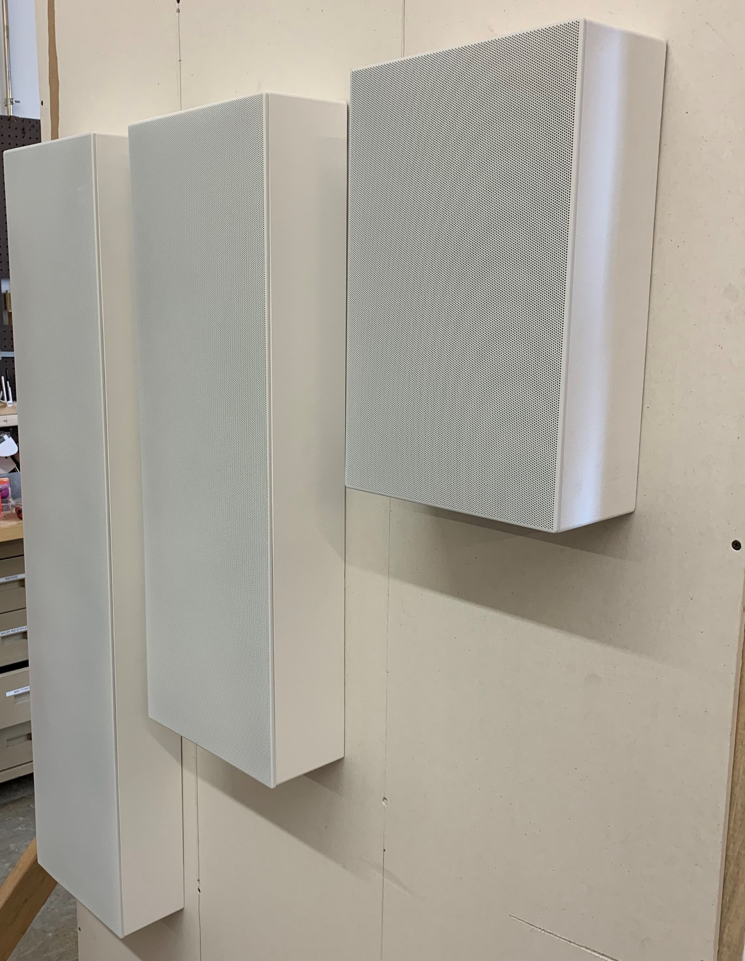
New Masterpiece CI Series
On-Wall Frames
Arriving after launch for 3XW, 5XW, and 7XW:
Ideal for creating a unique look, working around tough construction challenges, or makes for an ideal “slim” center channel solution.
Pricing and Availability TBD
**Coming Soon**
**Concept Prototypes Pictured**

Slide 27
New Masterpiece CI Series
Statement On-Wall Enclosure
On-Wall Enclosure Option for Statement available after launch:
Ideal for demo installations, custom designs, and more!
Pricing and Availability TBD
**Coming Soon**

Slide 28
Masterpiece CI Series
Available Mid March 2020
Statement Arriving Summer 2020

