Slide 1
Introducing, the MartinLogan MDA8 and MDA16

Slide 2
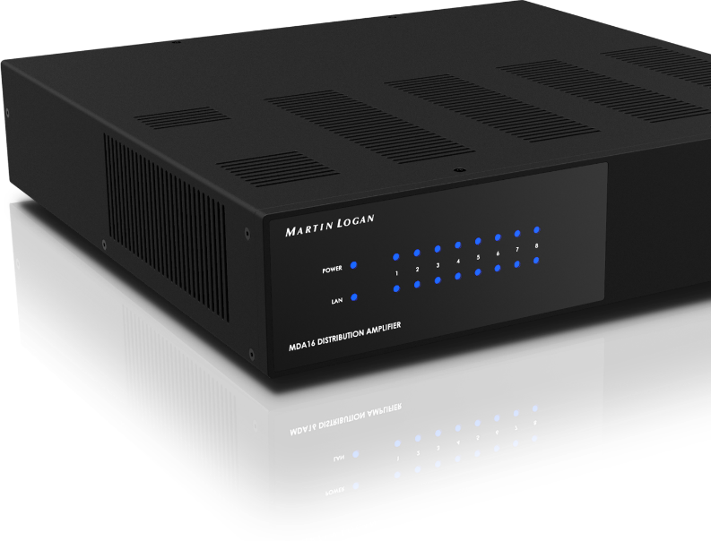

Slide 3
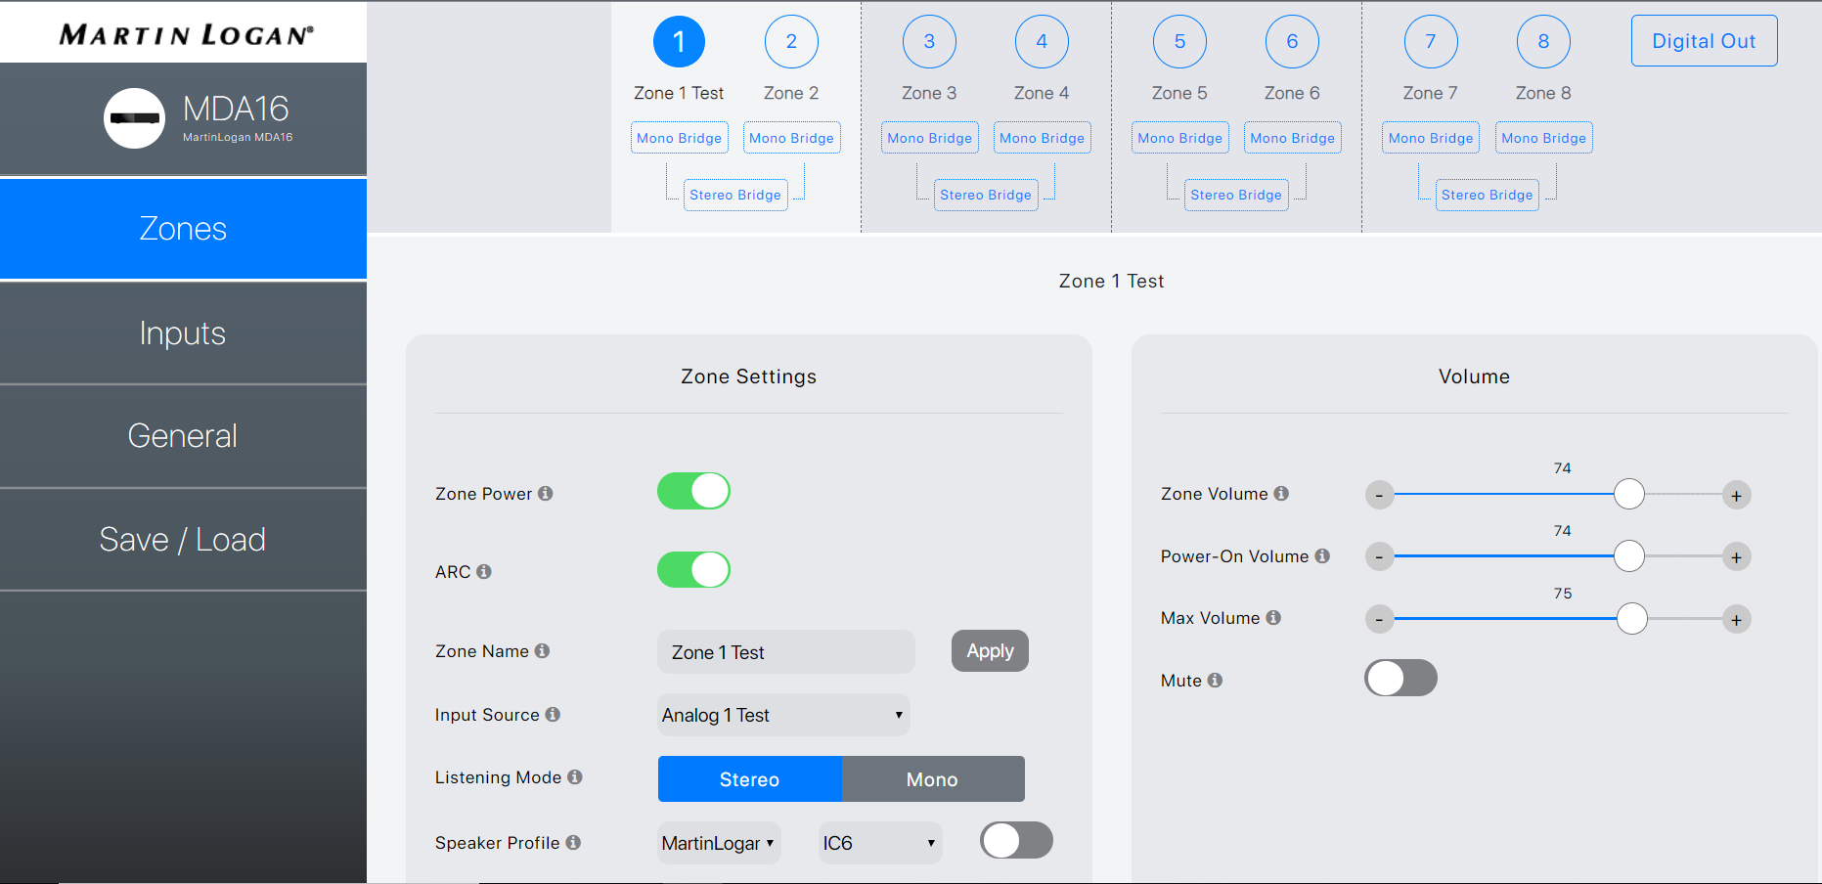
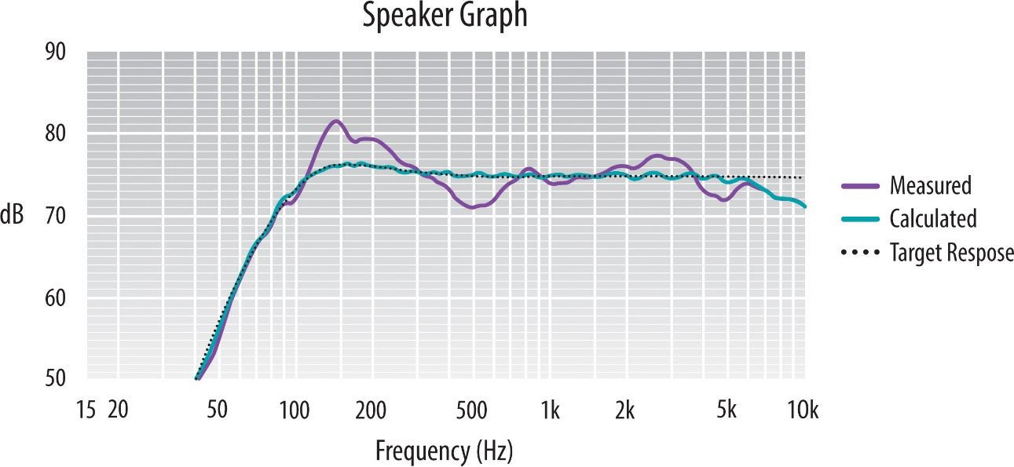
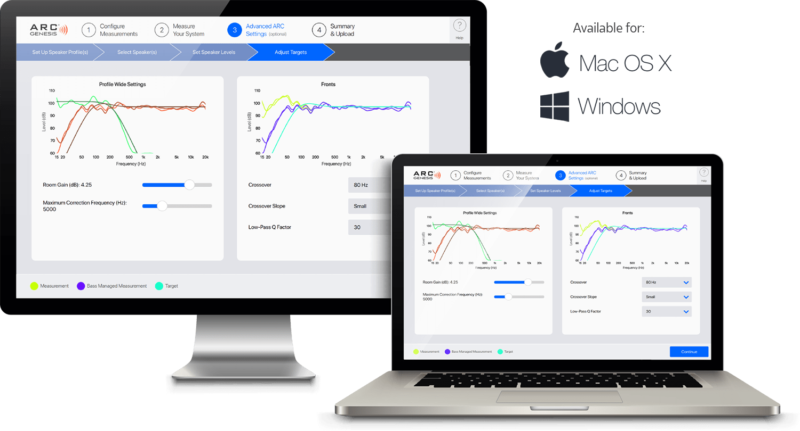
MDA8/16 Distribution Solutions
• An intuitive, adaptive web-based user interface makes easy work of setup, saving valuable time.
• Easy-To-Use and Powerful, Anthem Room Correction Delivers Professional Results.

Slide 4
MDA8/16 Distribution Solutions
Key Features and Benefits:
• 60 Watts (8 Ohms) / 120 Watts (4 Ohms) of Ultra-Class-D amplification with ALM (All Channels Driven)
• Bridge for up to 200 Watts
• 8- or 16-channels of amplification
• Full digital/analog matrix switching can be pre-configured via the web interface or switched in real time via IP/RS-232
• DSP Presets for all MartinLogan CI and Outdoor Products
• Independent Anthem Room Correction (ARC), bass management, bass/treble adjustments, and level control settings for each zone
• 24-bit/192kHz DAC with Hi-Res source support
• Daisy chaining capability
• Independent bass management and subwoofer integration for each zone

Slide 5
MDA8/16 Distribution Solutions
Web UI
• Simple On-site configuration and calibration using MDA’s intuitive Web-based controls
• The specially designed, adaptive user interface works on any device. Custom configure zones, input assignments, zone names, and adjust levels (and every aspect of performance) independently
• After configuration, run Anthem Room Correction (ARC Genesis) for each zone, and customize settings separately
• Save/Load configuration profiles for easy programming management
• Firmware updates with a single button press through the Web UI

Slide 6
MDA8/16 Distribution Solutions
Automation Compatibility
• Robust IP/RS-232 connection capability ensures compatibility with leading home automation systems, with easily downloaded drivers available for:

Slide 7
MDA8/16 Distribution Solutions
Zone Configuration Options
• Custom Names
• Multiple Inputs
• Independent Playback
• Tuning Controls
• Dedicated Sub-Outs
• Bass Management
• Crossover Frequency
• Level
• Phase
• Polarity

Slide 8
MDA8/16 Distribution Solutions
Digital Inputs and Switching
• MDA Amplifiers accept inputs up to 24-bit/192kHz over S/PDIF to provide the most flexibility supporting high-resolution source materials.
• Fast, efficient Ultra-Class-D amplification is supported by proprietary ALM technology, delivering reliable performance under even the most demanding loads. This high-efficiency design meets and exceeds global power-saving standards.
• Smooth, instantaneous digital switching output allows the linking of digital inputs between multiple amplifiers.
• Analog pass-through connections are also included, allowing daisy-chaining of multiple amplifiers.

Slide 9
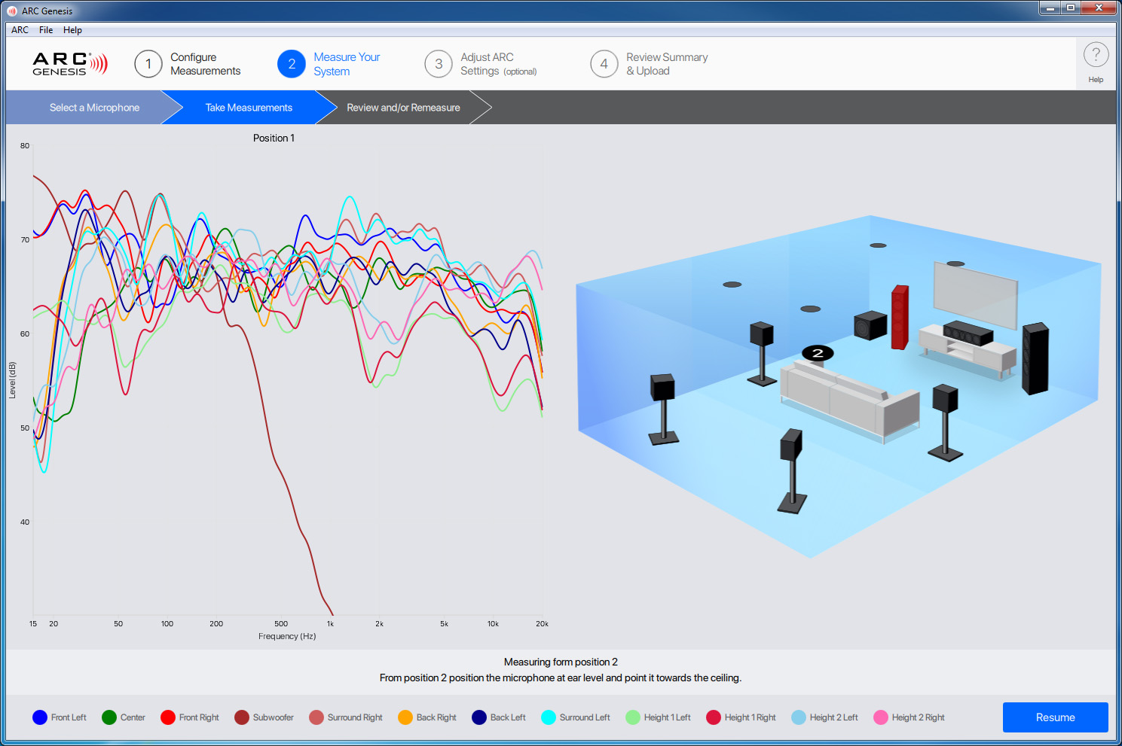
MDA8/16 Distribution Solutions
ARC Genesis
• Sophisticated User Experience
New look
Easily remeasure
• Improved Compatibility
MAC OSX support
Platform sharing
• Printable Reports
Customizable
• Backwards Compatibility
All ARC/PBK products
No software update required
• Mobile Support
Later date
Any ARC or PBK Mic
(ARC Mic Included)
Download ARC Genesis
For Mac or PC
Windows = 7/8/8.1/10
Mac OSX= 10.12+

Slide 10
MDA8/16 Distribution Solutions
Model Comparison
MDA8 | MDA16
4 (8) | 8 (16)
4 | 8
0 | 2
1 | 2
4 | 8
4 | 8
0 | 1
0 | 1
1 | 1
1 | 1
1 | 1
2 | 2
Zones (Channels)
Audio Inputs
Stereo RCA Analog Inputs
Coaxial RCA Digital Inputs
Toslink (Optical) Digital Inputs
Audio Outputs
Mono RCA Analog Sub Outputs
Stereo Speaker Level Outputs
60w @ 8ohm / 120w @ 4ohm / 200w Bridged
Stereo RCA Passthrough
Toslink (Optical) Digital Output
Control Connectivity
Ethernet - RJ-45 (10/100)
Micro USB (Type B)
RS-232
3.5mm Trigger Jacks (In/Out)

Slide 11
MDA8/16 Distribution Solutions
MDA8 Rear Panel

Slide 12
MDA8/16 Distribution Solutions
MDA16 Rear Panel

Slide 13
MDA8/16 Distribution Solutions
Whole Home Distributed Audio Examples

Slide 14
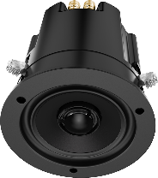
Whole Home Distributed Audio
Sources In
Zone 2 Out
200w x 1 @ 8Ω
Bridged
CI Sub
Zone 1 Out
MDA16 can power up to 4 independent 4.1 Zones of audio
MDA8 can power up to 2 independent 4.1 Zones of audio
60w x 2 @ 8Ω
120w x 2 @ 4Ω
4.1 Distributed Audio
(Requires 2 “Zones” of Power)

Slide 15
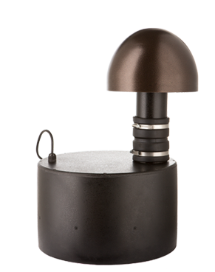
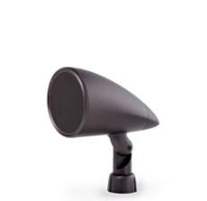
Whole Home Distributed Audio
Sources In
Zone 2 Out
200w x 1 @ 8Ω
Bridged
Zone 1 Out
MDA16 can power up to 4 independent 4.1 Zones of audio
MDA8 can power up to 2 independent 4.1 Zones of audio
60w x 2 @ 8Ω
120w x 2 @ 4Ω
4.1 Landscape Audio
(Requires 2 “Zones” of Power)

Slide 16
Whole Home Distributed Audio
Sources In
Zone 1 Out
Zone 8 Out
Zone 5 Out
CI Sub
Zone 2 Out
Zone 7 Out
Zone 3 Out
Zone 4 Out
MDA16:
3 x 4.1 Zones + 2 x 2.0 Zones
Zone 6 Out

Slide 17
Whole Home Distributed Audio
Sources In
Zone 1 Out
Zone 8 Out
Zone 5 Out
CI Sub
Zone 2 Out
Zone 7 Out
Zone 3 Out
Zone 4 Out
MDA16:
3 x 4.1 Zones + 2 x 2.0 Zones
Zone 6 Out

Slide 18
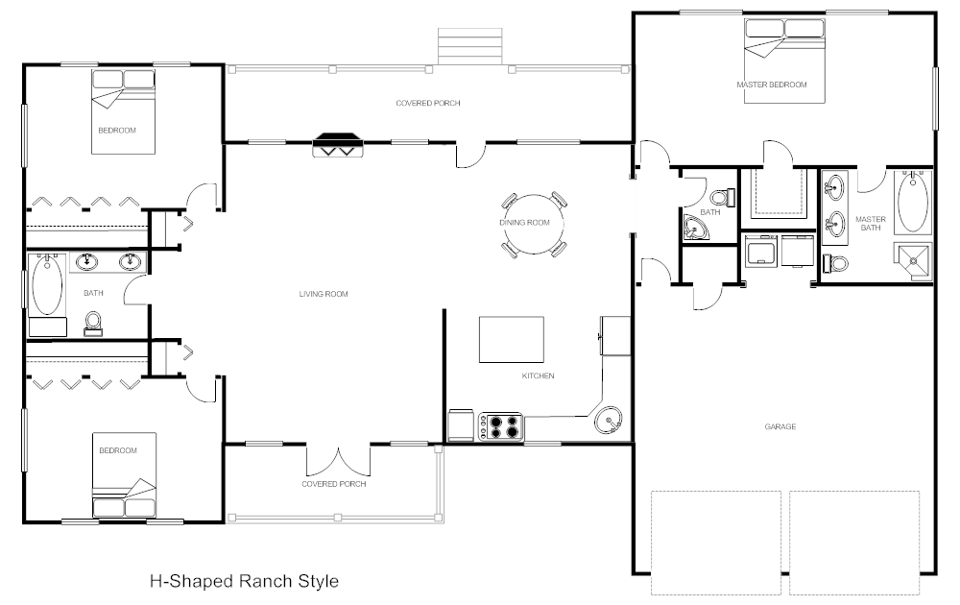
Whole Home Distributed Audio
Crown CDI1000
Master Bedroom
(Zone 3)
Analog Out
Bedroom
(Zone 5)
Dining Room
(Zone 2)
Master Bath
(Zone 4)
MDA16
Bathroom
(Zone 7)
Kitchen
(Zone 1)
Bedroom
(Zone 6)

Slide 19
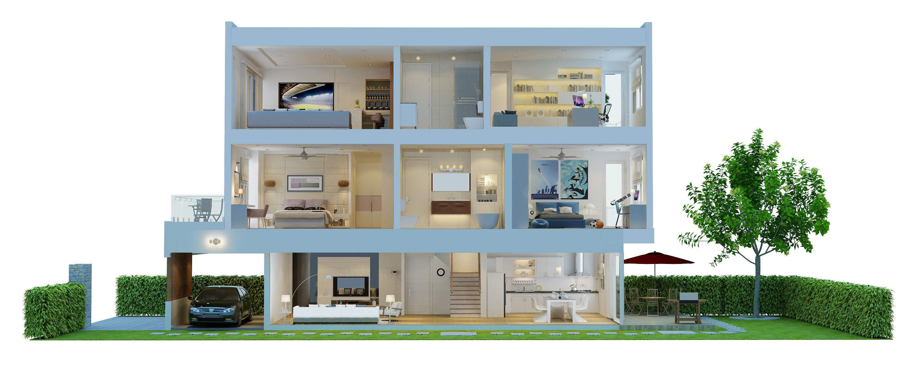
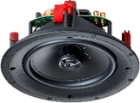
Whole Home Distributed Audio
MDA8
$1,999
Master Bedroom
(Zone 2)
Kitchen
(Zone 1)
Outdoor
(Zone 3 + Sub powered by Zone 4)
2x Rooms of Audio with Independent Volume and Source Selection + 1x Independent Outdoor 4.1 Zone of Audio
MDA8 + 4x IC3 + 2x IC8 + Outdoor Living 4.1 Bundle =
$6,808

Slide 20
Whole Home Distributed Audio
MDA16
$2,999
Office
(Zone 6)
Master Bedroom
(Zone 3)
Master Bath (Zone 4)
Bedroom 2
(Zone 5)
Common Area
(Zone 2)
Kitchen
(Zone 1)
Outdoor
(Zone 7 + Sub powered by Zone 8)
6x Rooms of Audio with Independent Volume and Source Selection + 1x Independent Outdoor 4.1 Zone of Audio
MDA16 + 4x IC3 + 4x IC3 + 2x IC8 + 1x IC8-AW + 2x IC8 + 2x IC8 + Outdoor Living 4.1 Bundle =
$10,319

